Slide 1
Warehouse management system
Presented by:
Shubham Lathiya
Priyank Mangaroliya
supervisor by:
Dr. Kamlesh meshram
prof. Abhijita puhan

Slide 2
Introduction
A Warehouse Management System (WMS) is essential for efficiently managing inventory, order processing, and warehouse operations. It enhances operational efficiency by providing real-time visibility into inventory, optimizing space utilization, and ensuring order accuracy. By automating processes such as receiving, picking, packing, and shipping, a WMS helps reduce administrative overhead and minimize errors.

Slide 3
Objectives
This Warehouse Management System (WMS) is designed to help warehouse operations be more efficient, accurate, and productive. Using this system, user can track inventory in real time, streamline order fulfillment, and optimize warehouse space. WMS reduces operational costs, minimizes errors, and improves workflow by automating key tasks like inventory receiving, picking, packing, and shipping.

Slide 4
scope
The scope of this Warehouse Management System (WMS) is limited to managing the operations of a single company’s warehouse, focusing on inventory management, order processing, picking, packing, shipping, reporting and analytics. It will generate detailed reports and analytics for better decision-making.
The project will not include multi-warehouse management, or complex integrations. It will not include return and replace options.

Slide 5
Requirements specification
Admin Functional Requirements:
Login
View Dashboard
Manage Users
Manage Products
Manage Stock
View Clients
Manage Orders
View Reports
View Profile
Manage Role Permission

Slide 6
Requirements specification
Manager Functional Requirements:
Login
View Dashboard
Manage Products
Manage Stock
View Clients
Manage Orders
View Reports
View Profile

Slide 7
Requirements specification
Employee Functional Requirements:
Login
View Orders
Manage Tasks
View Profile

Slide 8
Requirements specification
Supplier Functional Requirements:
Login
View Orders
Deliver Order
Receive Payment
Print Invoice
View Profile

Slide 9
Requirements specification
Client Functional Requirements:
Register
Login
View Products
Add Orders
Track Orders
View Order History
Print Invoice
View Profile

Slide 10
Requirements specification
Non-Functional Requirements:
Security and Data Protection
Email Service
Usability
Availability

Slide 11
Tools and Technologies
Technologies:
Frontend: HTML, CSS, JavaScript
Backend: Python(Flask)
Database: MongoDB
Tools:
PyCharm
MongoDBCompass

Slide 12
Feasibility Study
Technical Feasibility: Python, MongoDB, and web frameworks (Flask) are used to build robust and scalable systems as part of the project.
Economic Feasibility: Automating order processing and inventory management will improve warehouse efficiency, reduce operational costs, and enhance customer satisfaction.
Operational Feasibility: Role-based access control ensures proper and secure use of system features, minimizing operational risks.

Slide 13
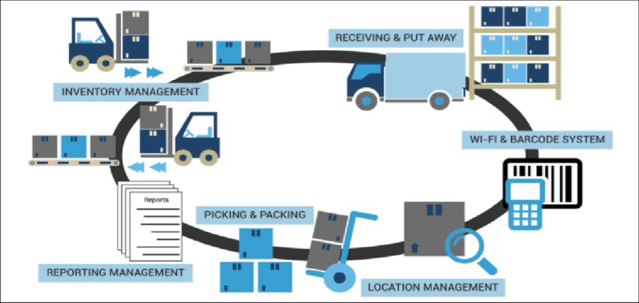
System Architecture
13

Slide 14
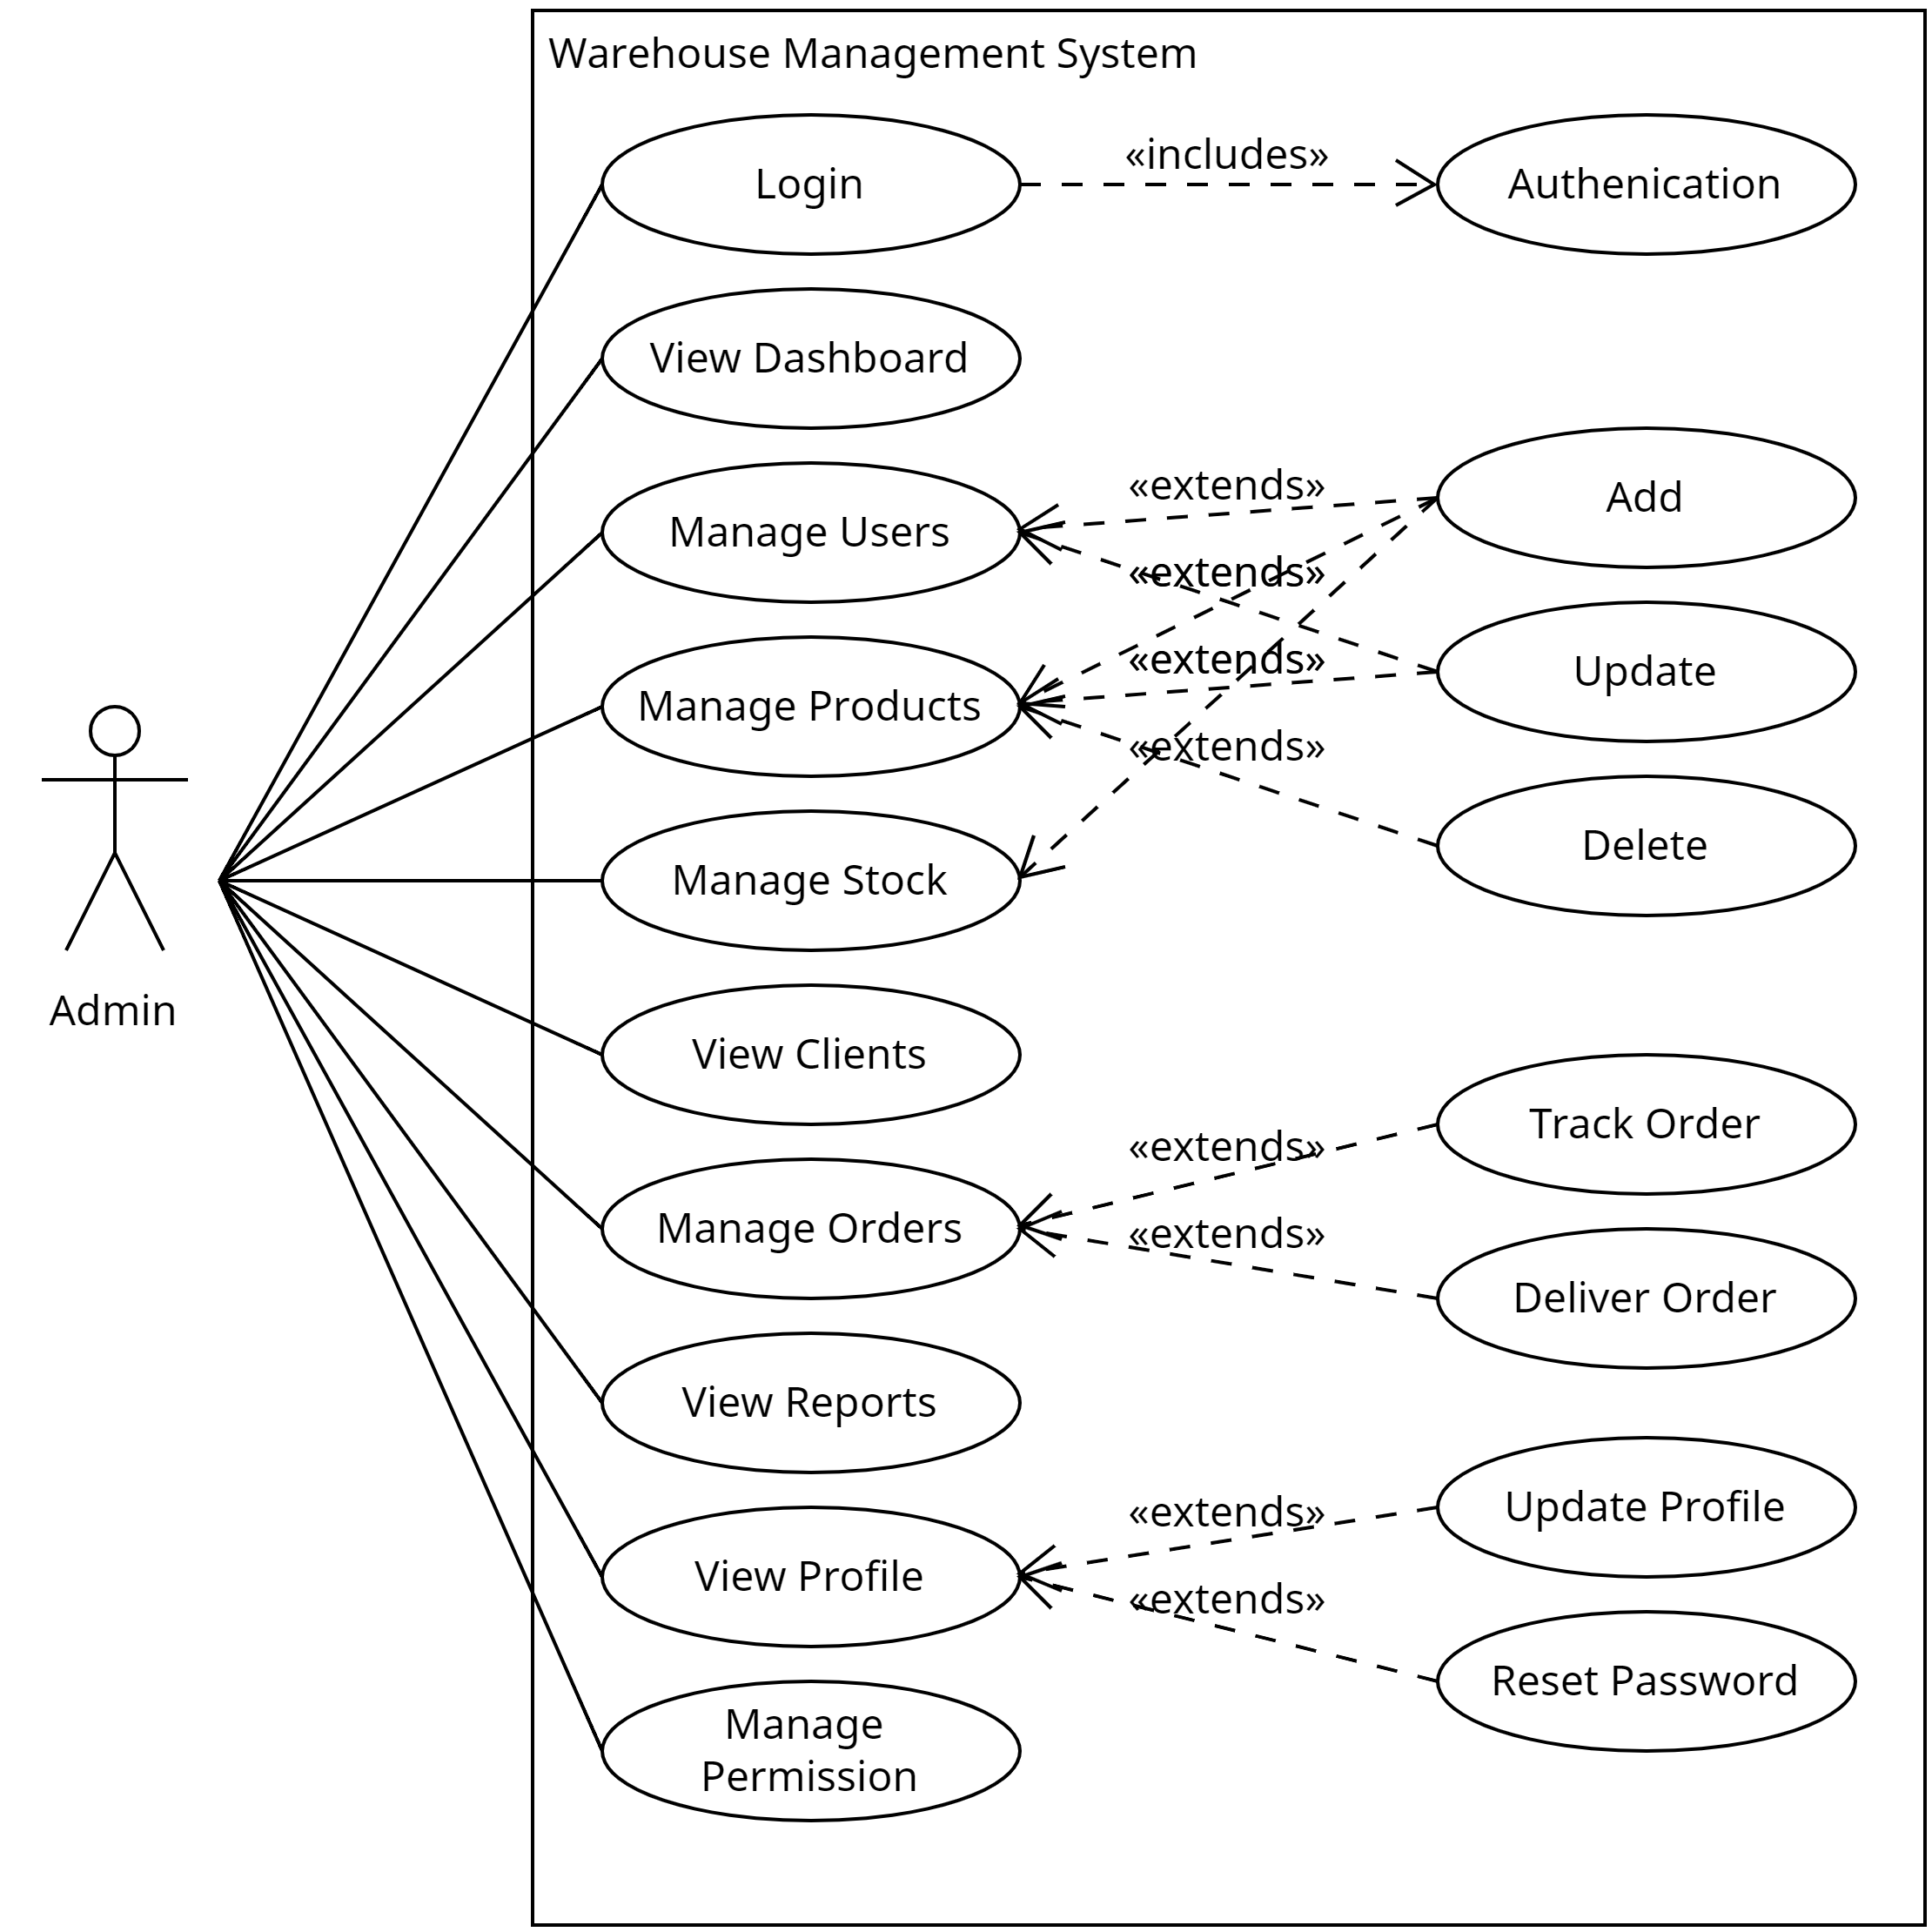
Admin Use case Diagram
14

Slide 15
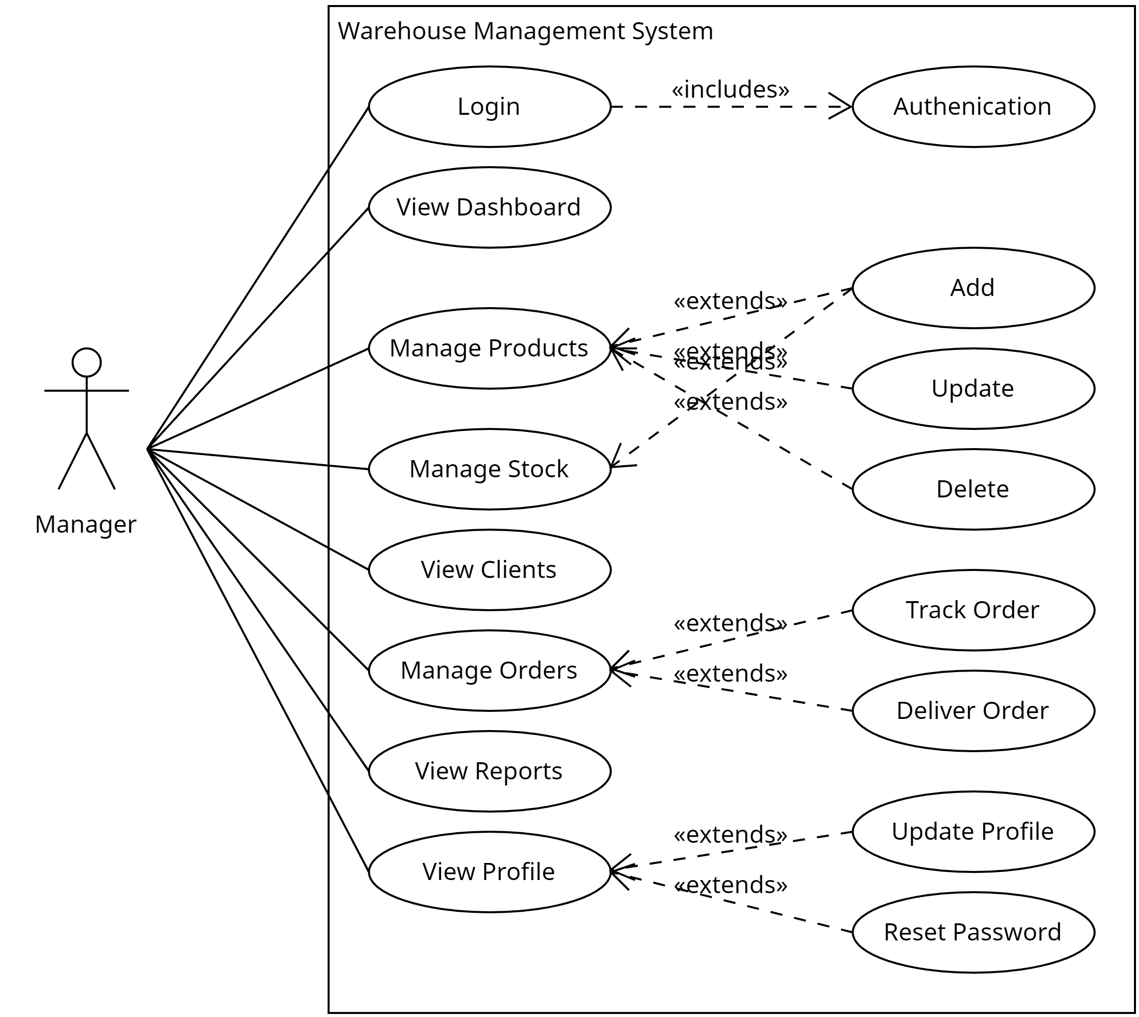
Manager Use case Diagram
15

Slide 16
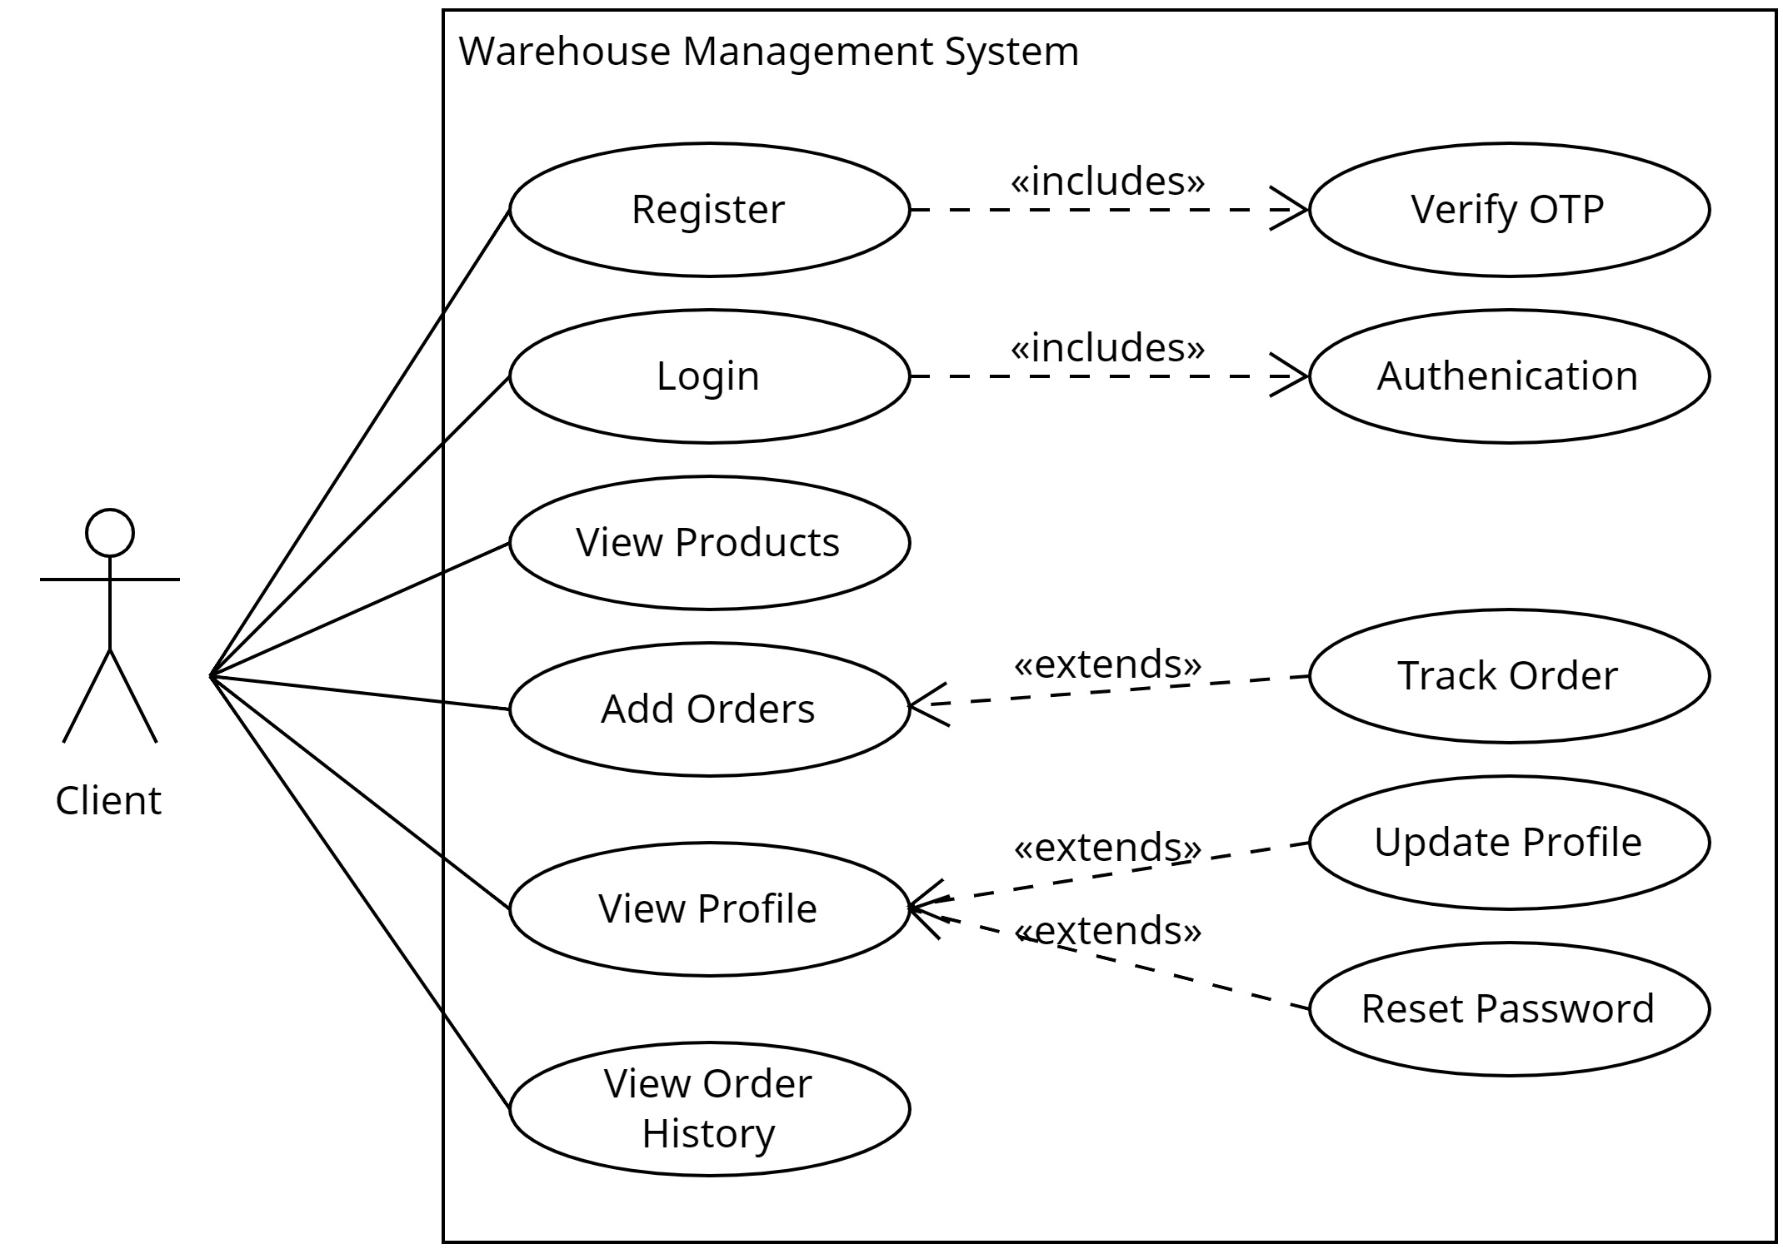
Client Use case Diagram
16

Slide 17
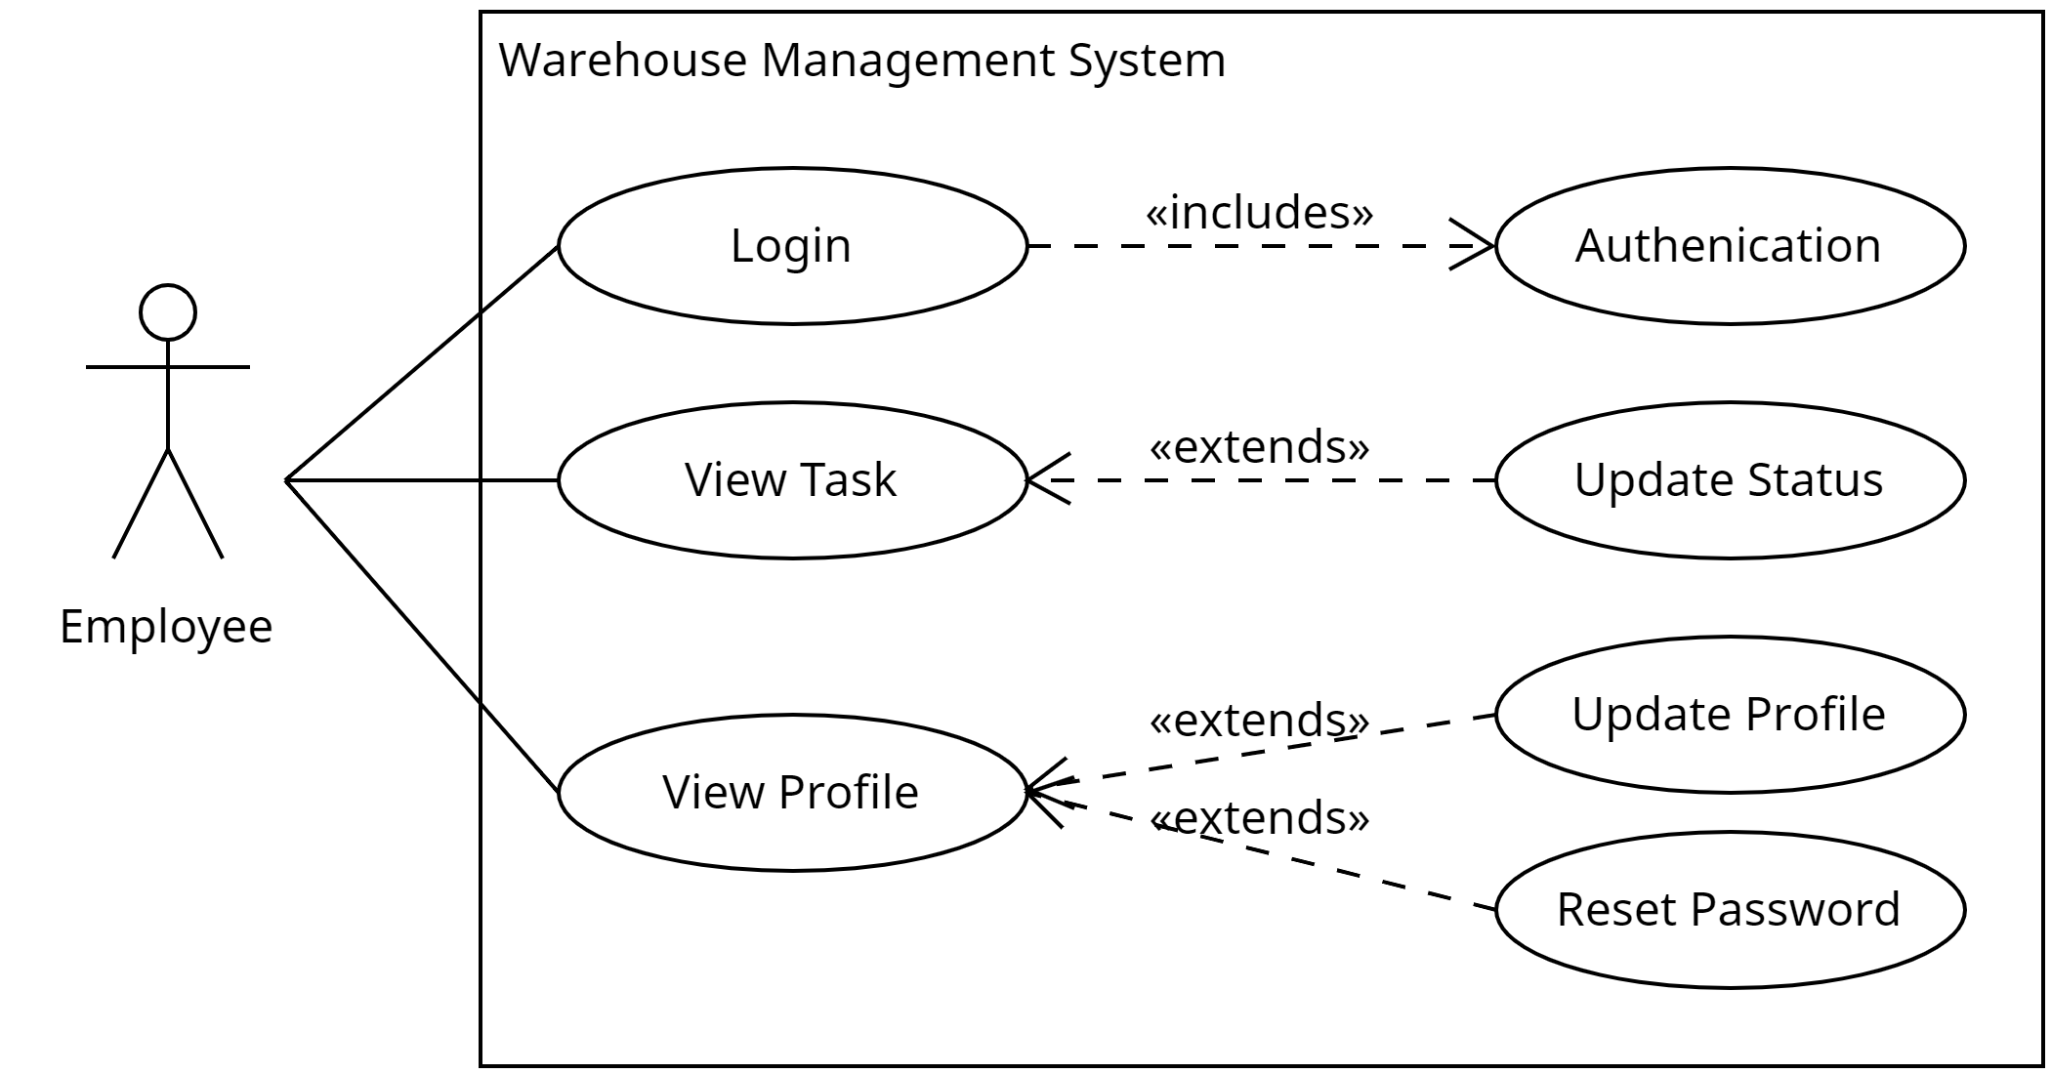
Employee Use case Diagram
17

Slide 18
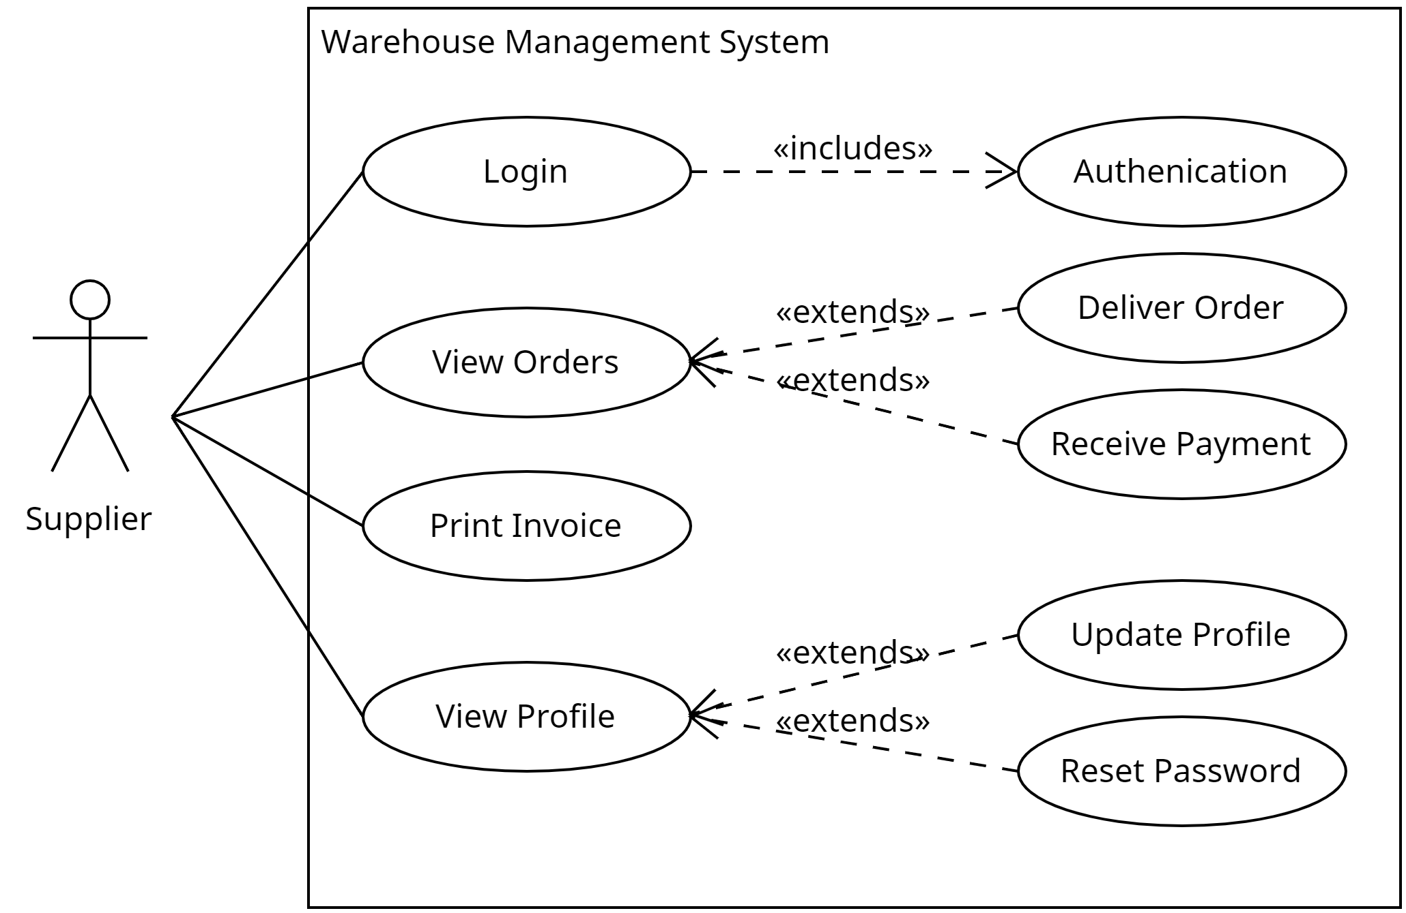
Supplier Use case Diagram
18

Slide 19
Database Design
19
user
Attribute | Data Type | Constraints
_id | ObjectId | Primary Key, Not Null, Unique
full_name | String | Not Null
mobile | String | Not Null, Unique
email | String | Not Null, Unique
password | String | Not Null
role | String | Not Null
status | String | Not Null
city | String | Not Null
area | String | Not Null

Slide 20
Database Design
20
product
Attribute | Data Type | Constraints
_id | ObjectId | Primary Key, Not Null, Unique
product_name | String | Not Null
sku | Long | Primary Key, Not Null, Unique
unit | Integer | Not Null
min | Integer | Not Null
max | Integer | Not Null
price | Float | Not Null
status | String | Not Null
description | String | Not Null
created_by | String | Not Null
area_id | ObjectId | Not Null, Foreign Key (References area(area_id))
image | String | Not Null
created_at | Date | Not Null

Slide 21
Database Design
21
area
Attribute | Data Type | Constraints
_id | ObjectId | Primary Key, Not Null, Unique
area_name | String | Not Null, Unique
no_box | Integer | Not Null
status | String | Not Null

Slide 22
Database Design
22
stock
Attribute | Data Type | Constraints
_id | ObjectId | Primary Key, Not Null, Unique
sku | Long | Not Null, Unique, Foreign Key (References products(sku))
date | Date | Not Null
+qty | Integer | Not Null
-qty | Integer | Not Null
total_qty | Integer | Not Null

Slide 23
Database Design
23
order
Attribute | Data Type | Constraints
_id | ObjectId | Primary Key, Not Null, Unique
user_id | ObjectId | Not Null, Foreign Key (References users(user_id))
products | Array of Object | Not Null
total_amount | Float | Not Null
payment_type | String | Not Null
order_date | Date | Not Null
status | Array of Object | Not Null
otp | Integer | Not Null

Slide 24
Database Design
24
transactions
Attribute | Data Type | Constraints
_id | ObjectId | Primary Key, Not Null, Unique
order_id | ObjectId | Not Null, Foreign Key (References orders(order_id))
amount | Float | Not Null
payment_type | String | Not Null
payment_status | String | Not Null
transaction_date | Date | Not Null

Slide 25
Database Design
25
case_collections
Attribute | Data Type | Constraints
_id | ObjectId | Primary Key, Not Null, Unique
order_id | ObjectId | Not Null, Foreign Key (References orders(order_id))
amount | Float | Not Null
submission_date | Date | Not Null
supplier_id | ObjectId | Not Null, Foreign Key (References suppliers(supplier_id))
status | String | Not Null

Slide 26
Database Design
26
assign_tasks
Attribute | Data Type | Constraints
_id | ObjectId | Primary Key, Not Null, Unique
order_id | ObjectId | Not Null, Foreign Key (References orders(order_id))
employee_id | ObjectId | Not Null, Foreign Key (References users(user_id))
assigned_date | Date | Not Null
status | String | Not Null
supplier_id | ObjectId | Not Null, Foreign Key (References suppliers(supplier_id))

Slide 27
Database Design
27
area
Attribute | Data Type | Constraints
_id | ObjectId | Primary Key
page_name | String | Not Null, Unique,
roles | Object | Not Null

Slide 28
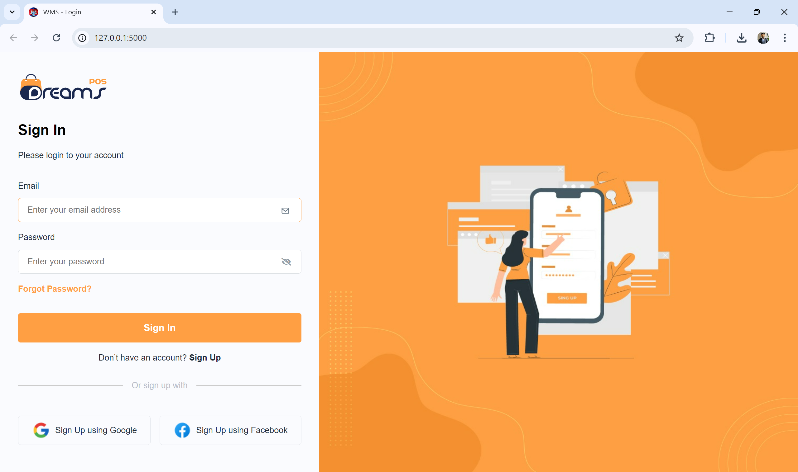
User Interface
28

Slide 29
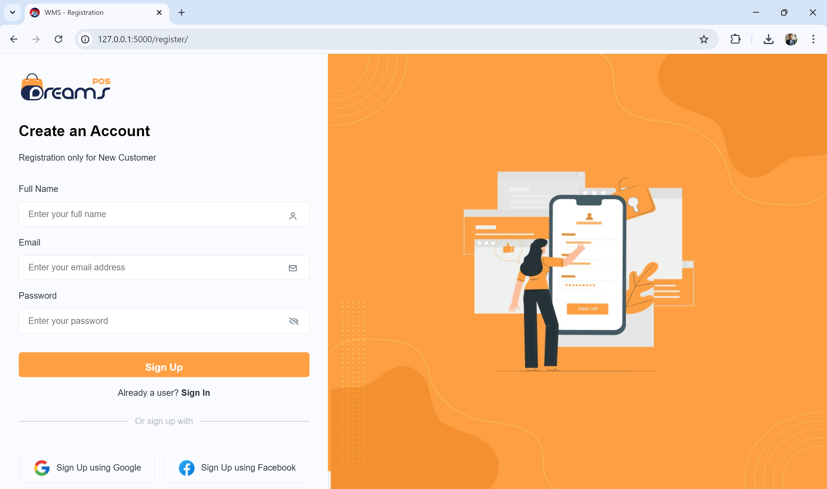
User Interface
29

Slide 30
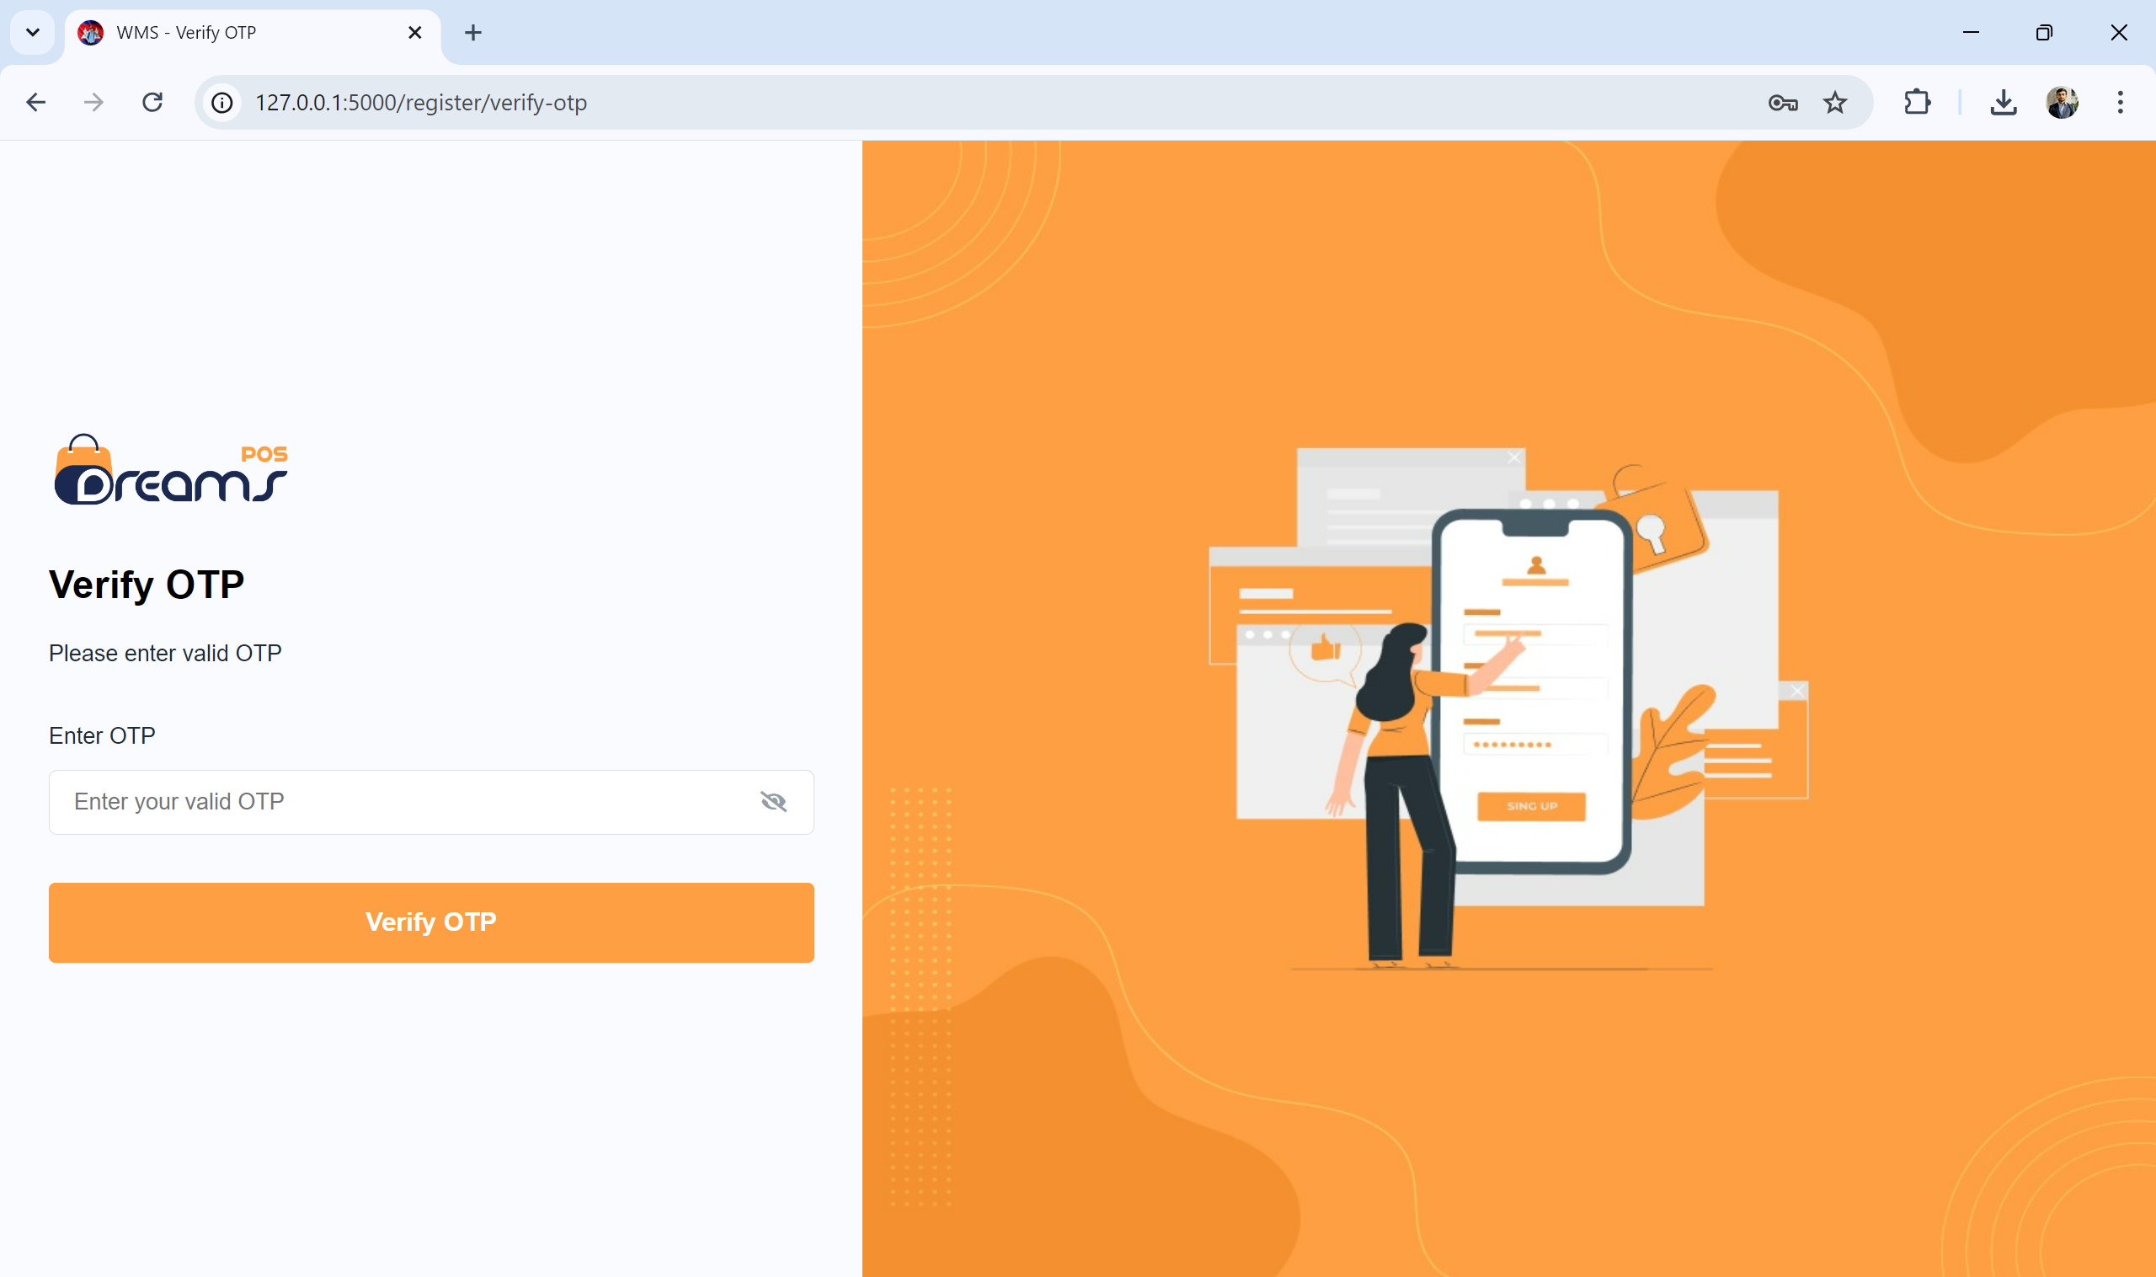
User Interface
30

Slide 31
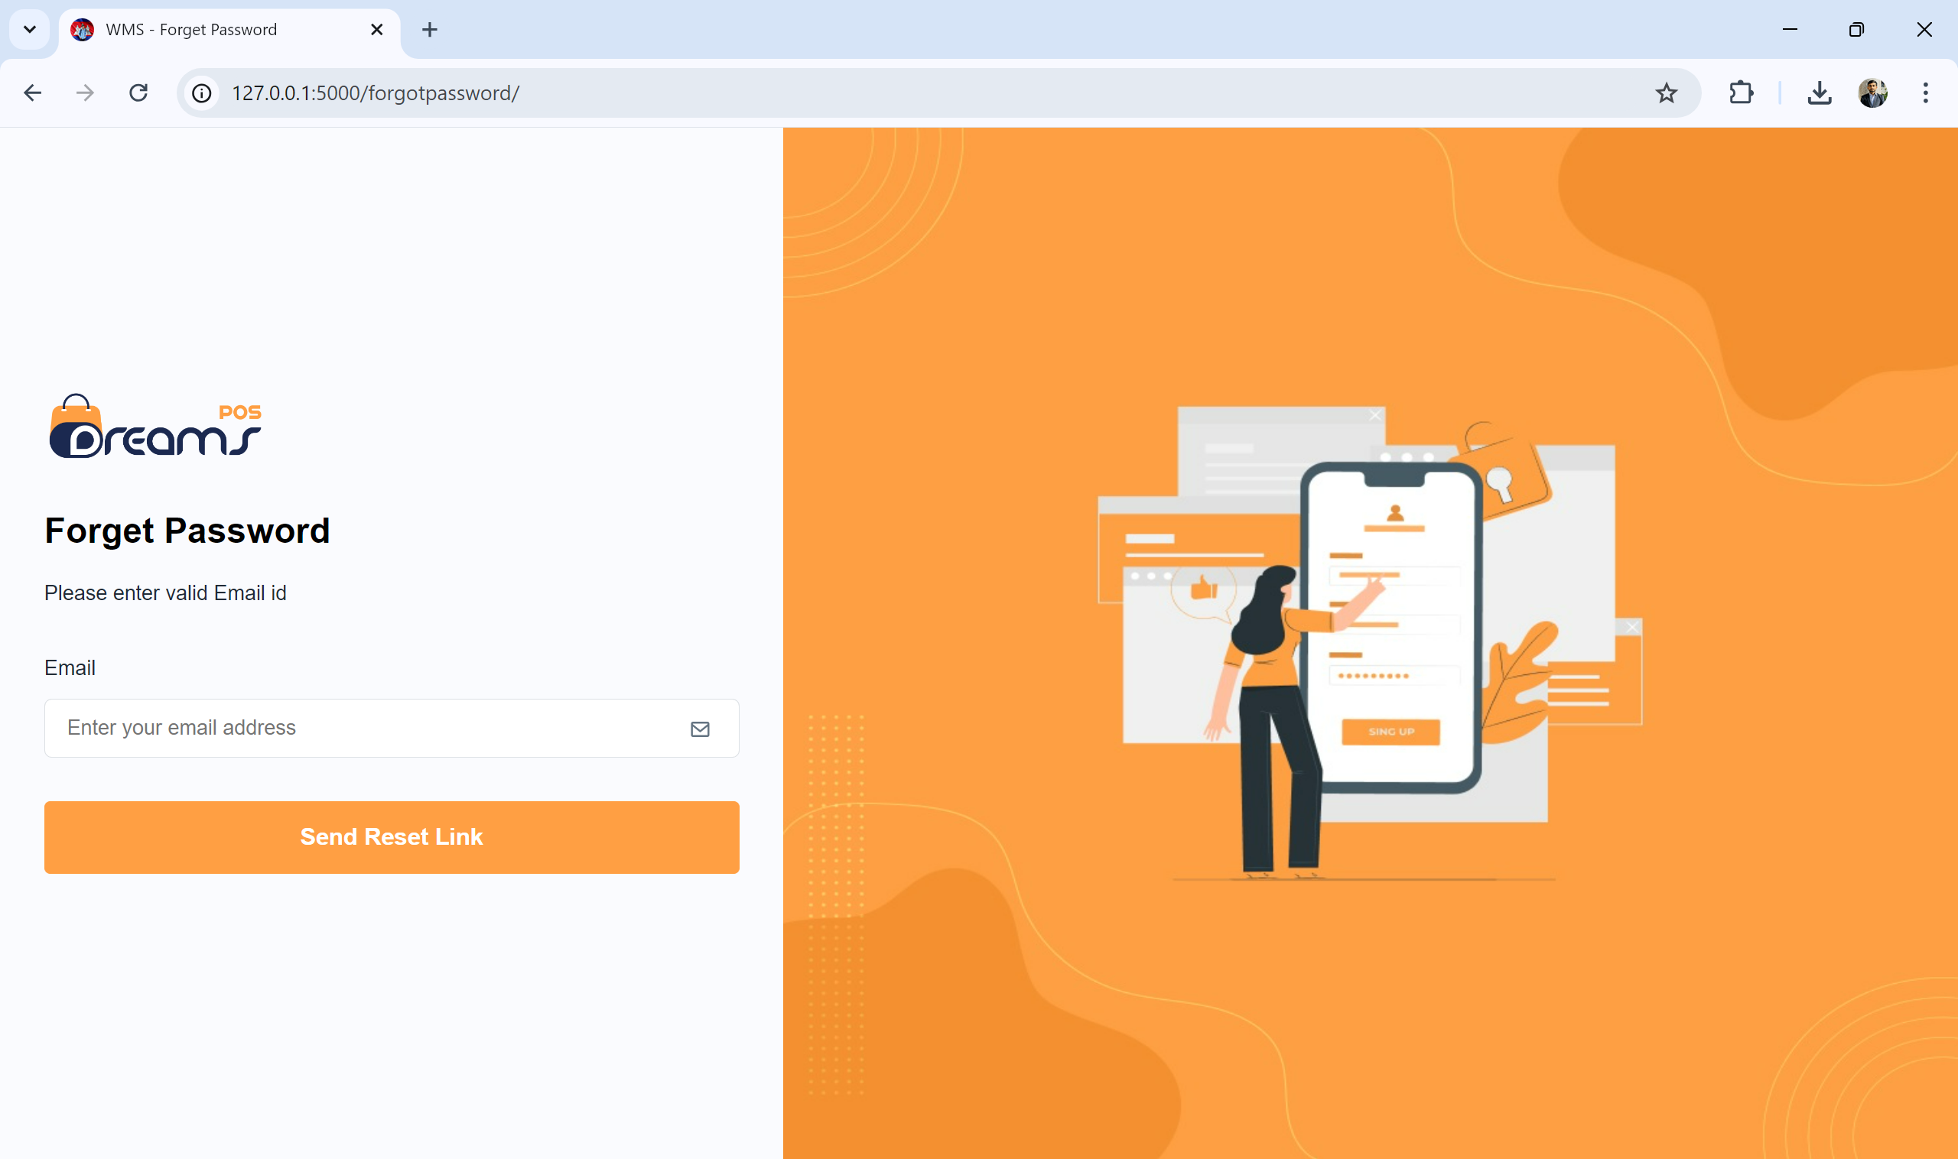
User Interface
31

Slide 32
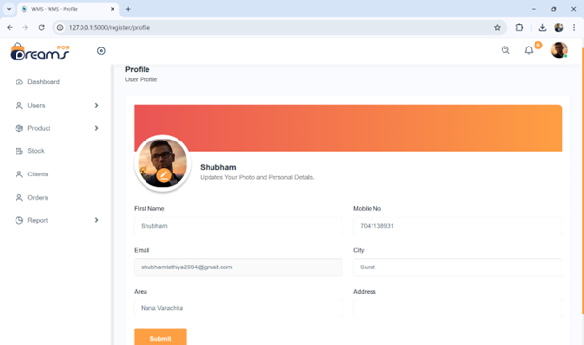
User Interface
32

Slide 33
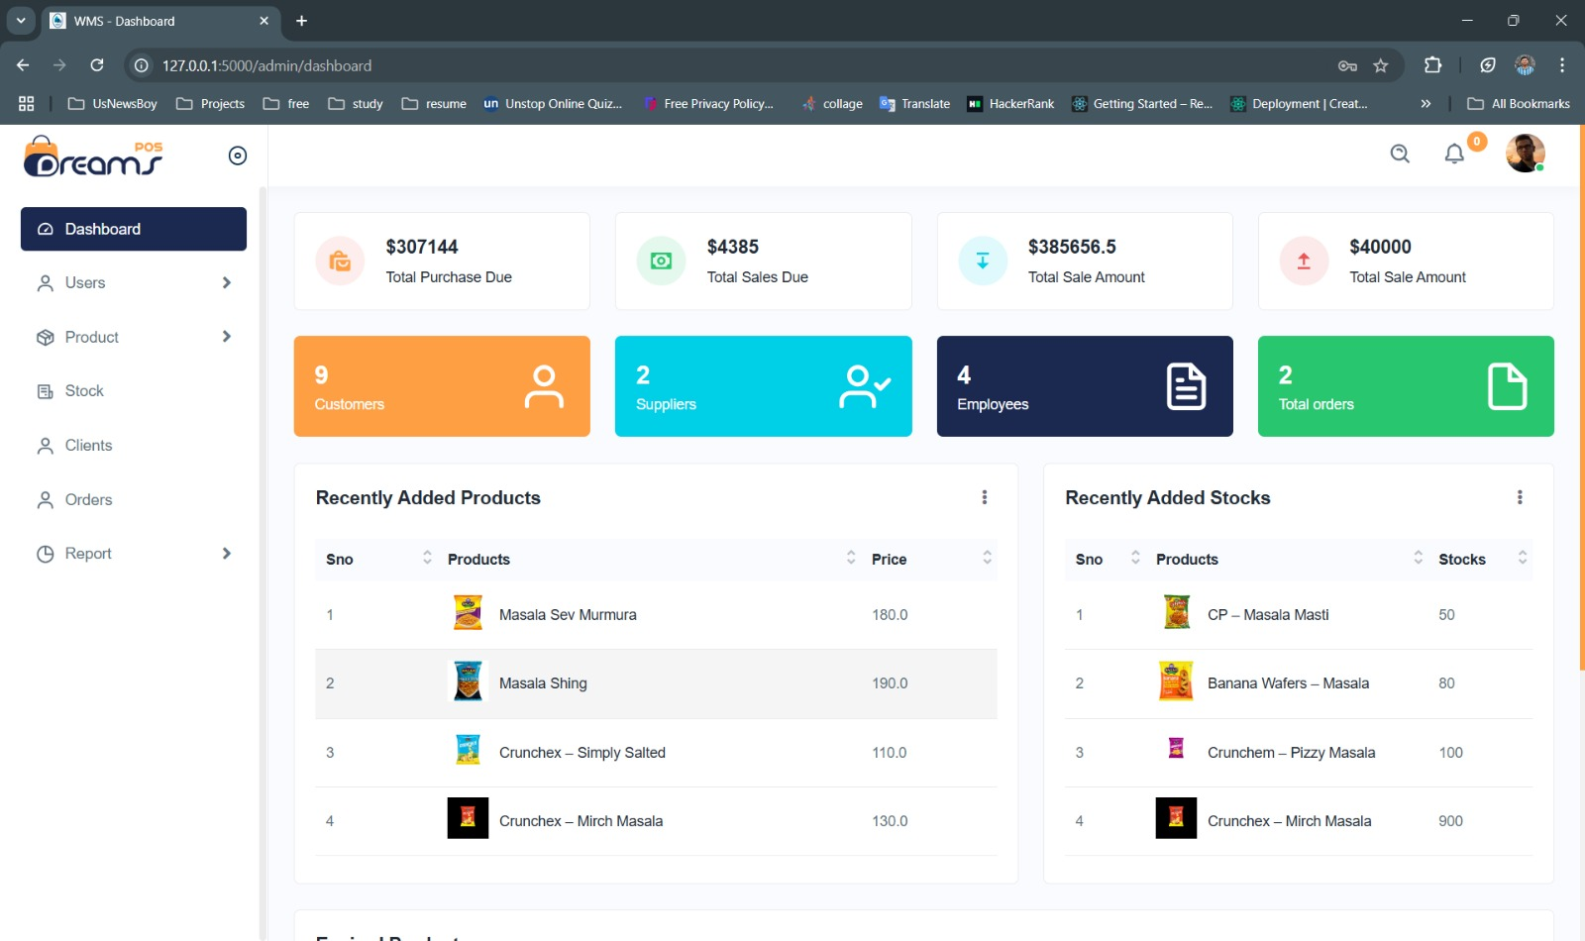
User Interface
33

Slide 34
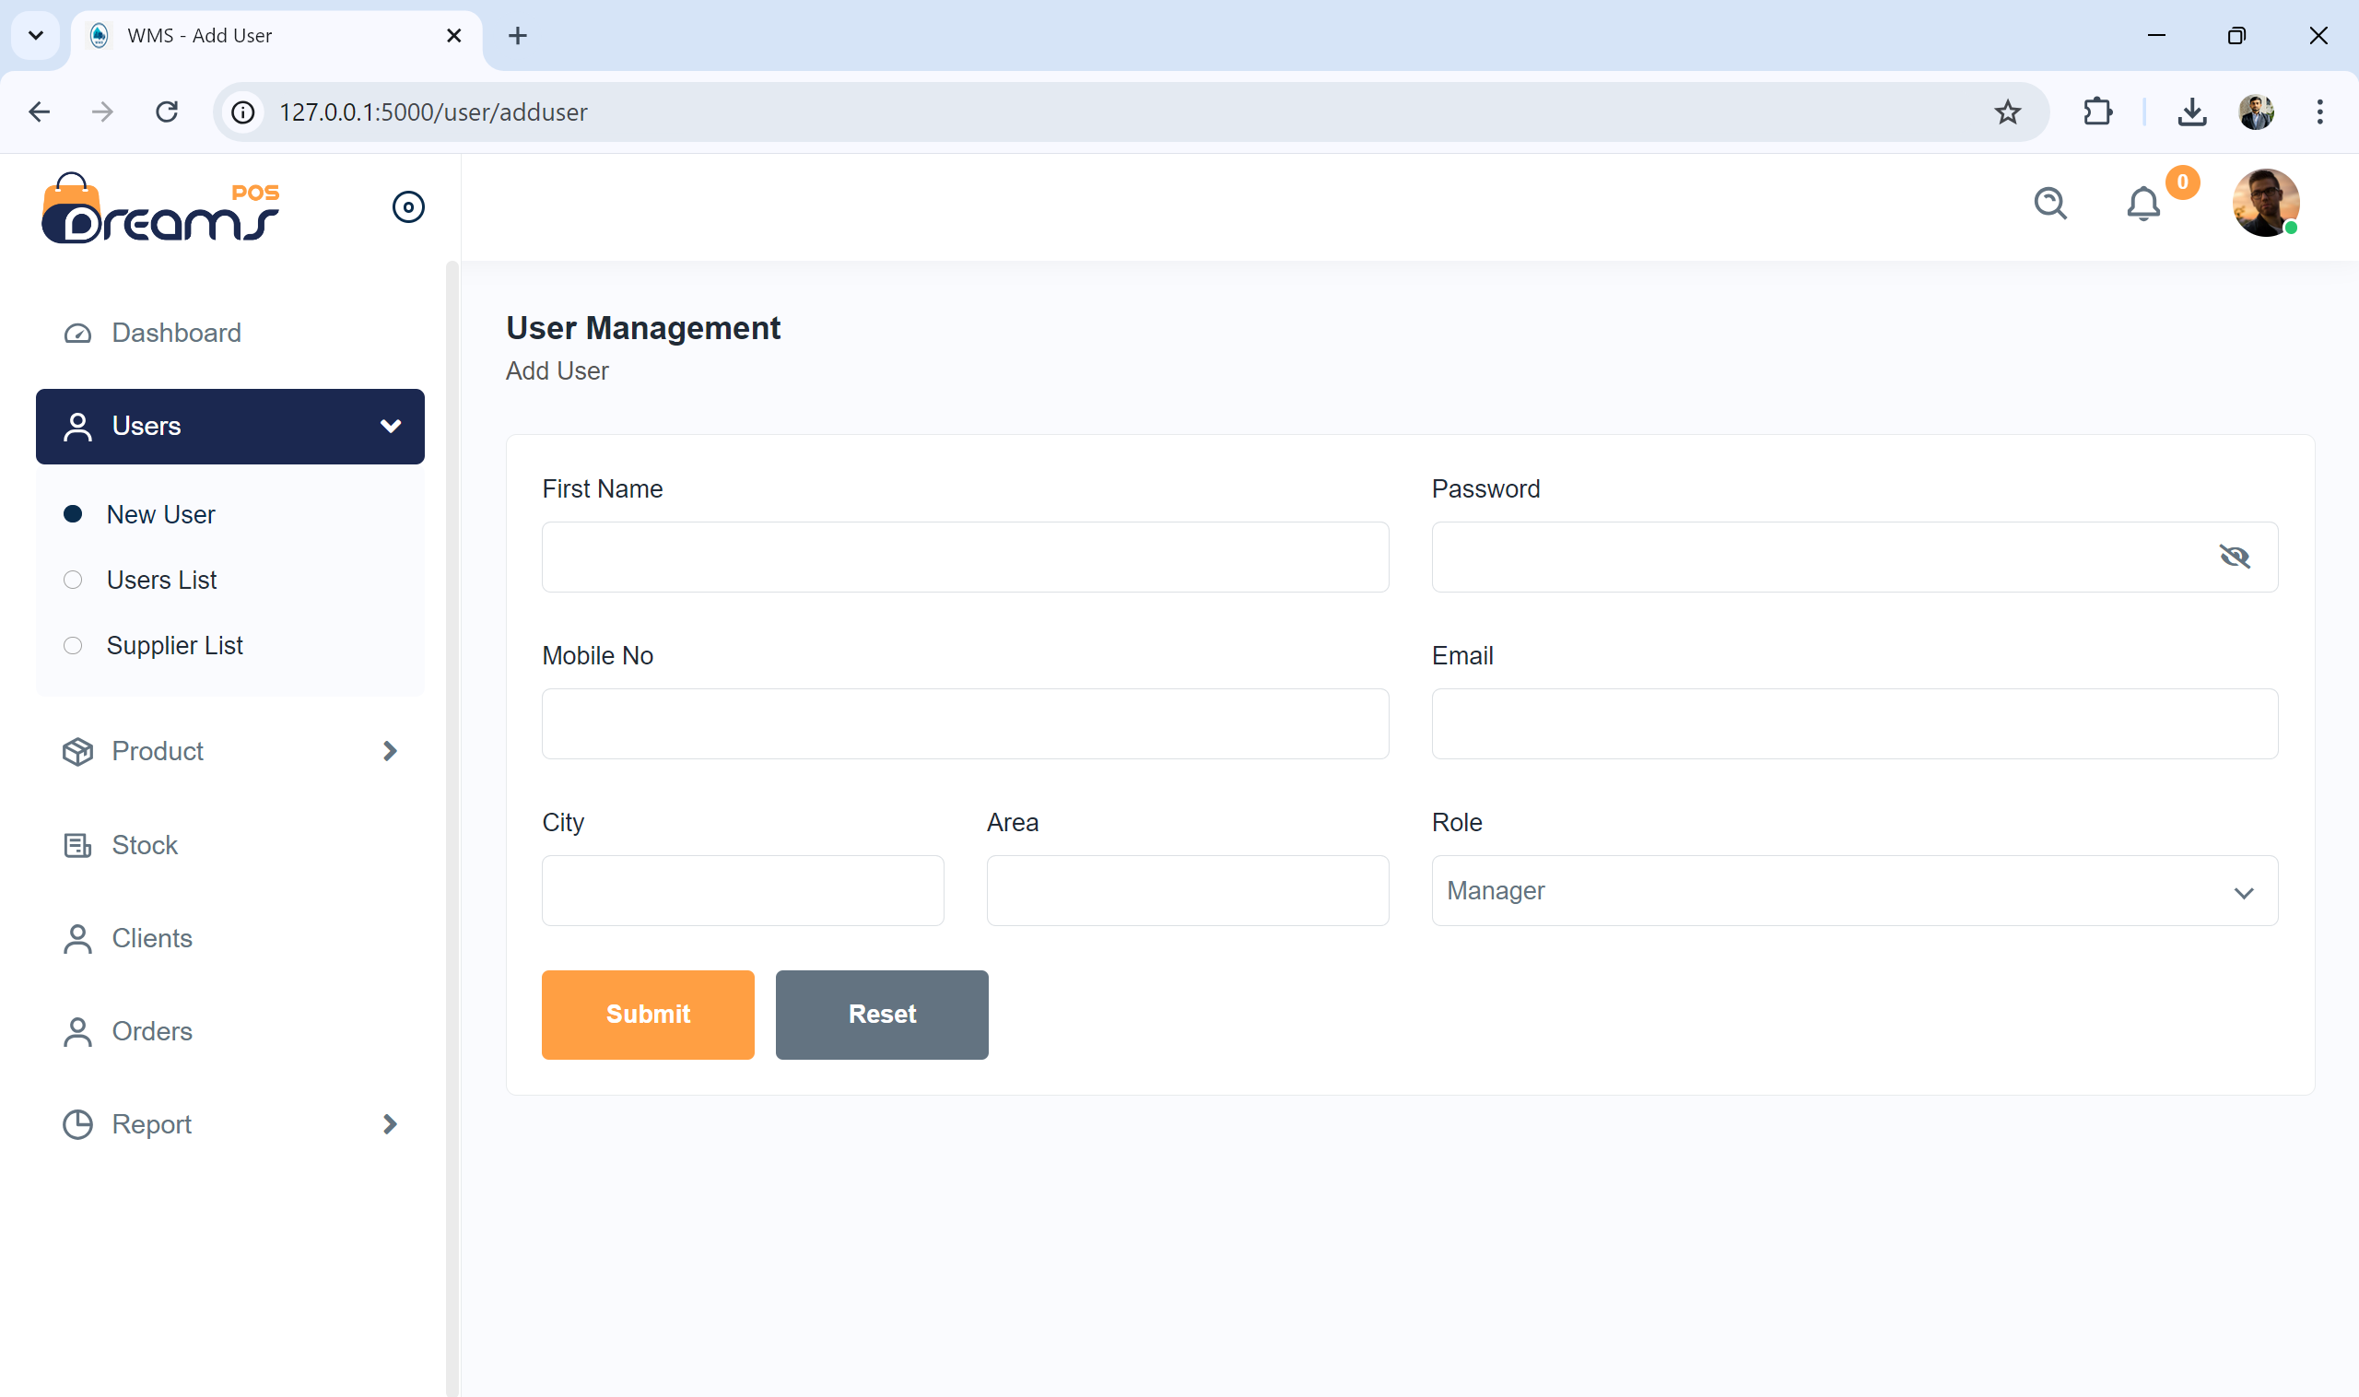
User Interface
34

Slide 35
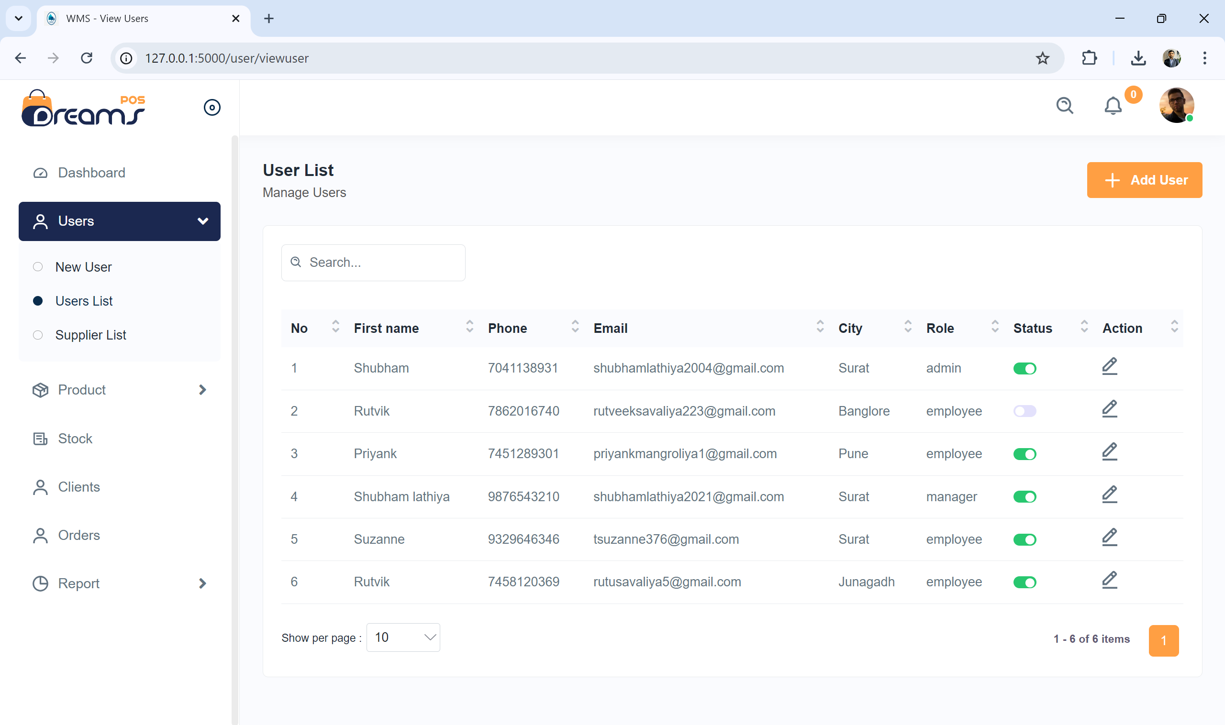
User Interface
35

Slide 36
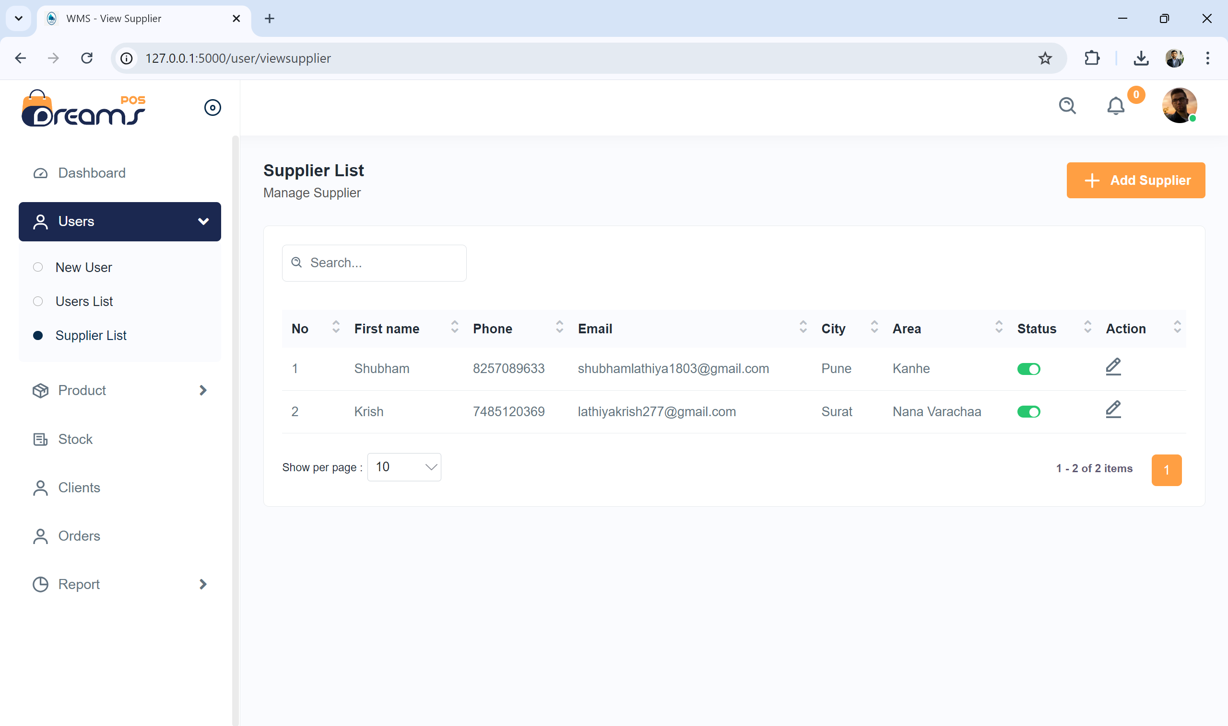
User Interface
36

Slide 37
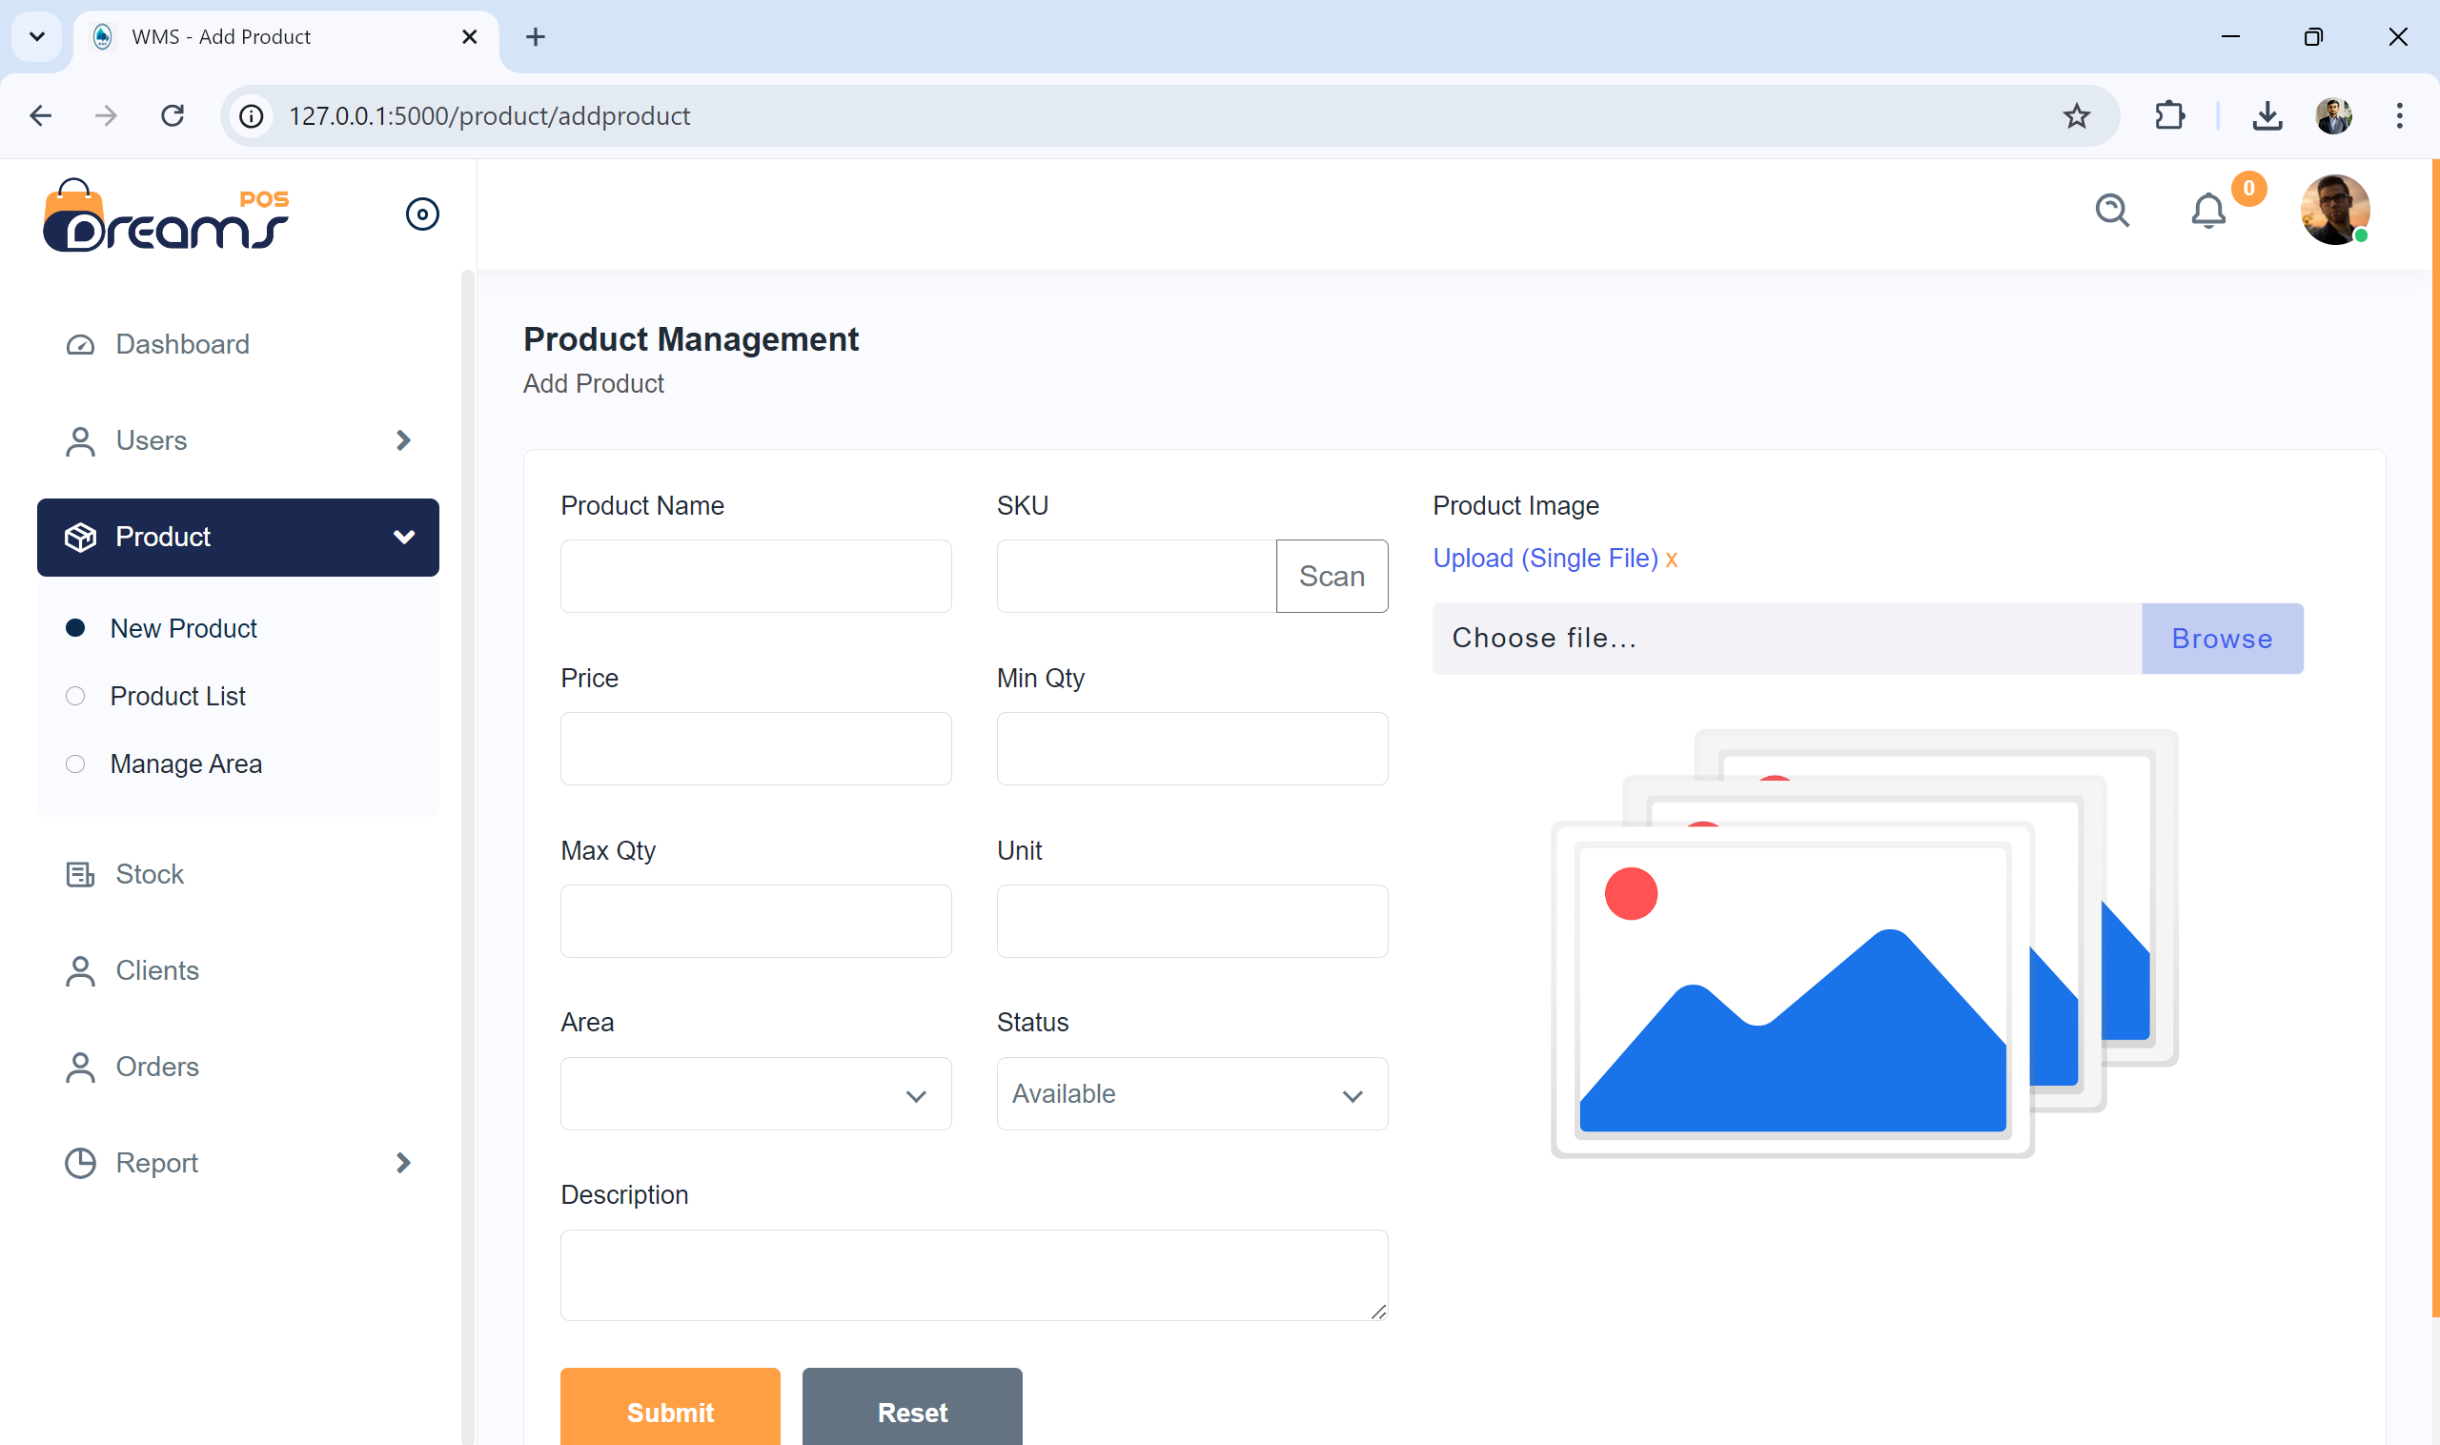
User Interface
37

Slide 38
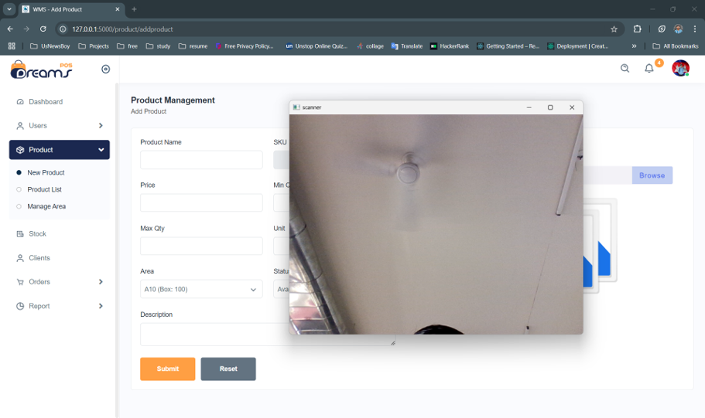
User Interface
38

Slide 39
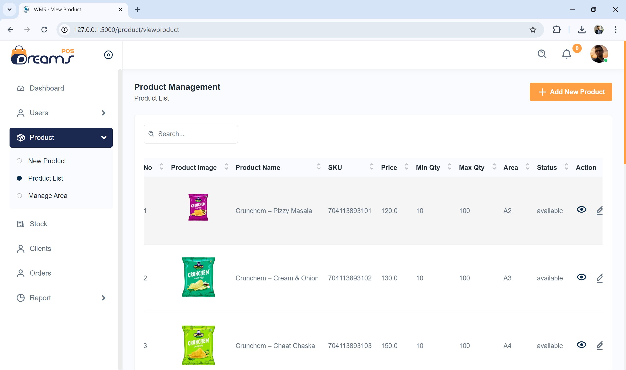
User Interface
39

Slide 40
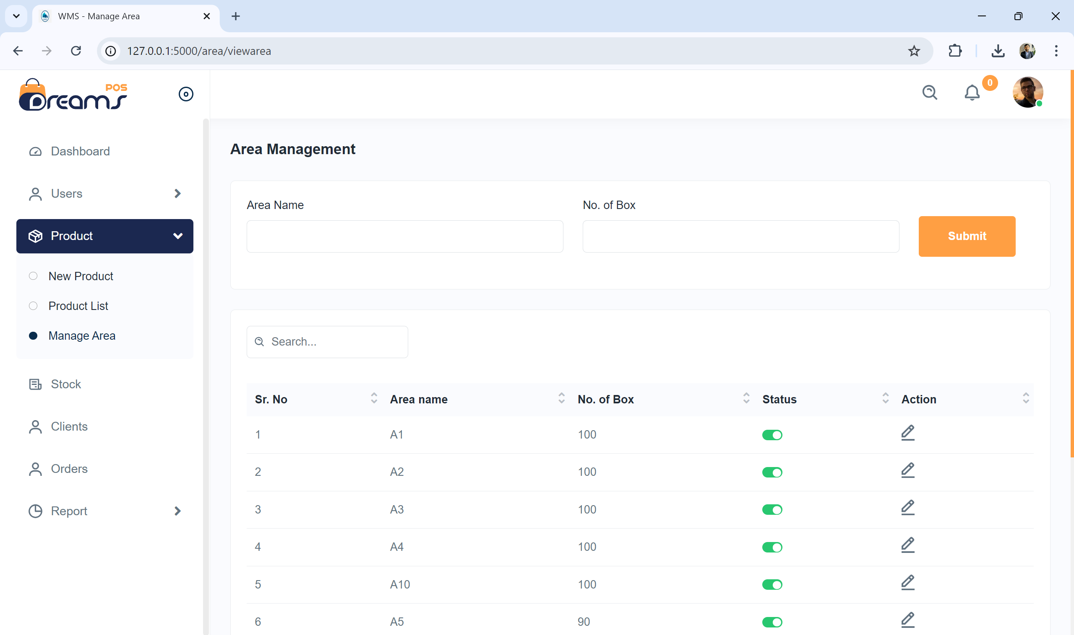
User Interface
40

Slide 41
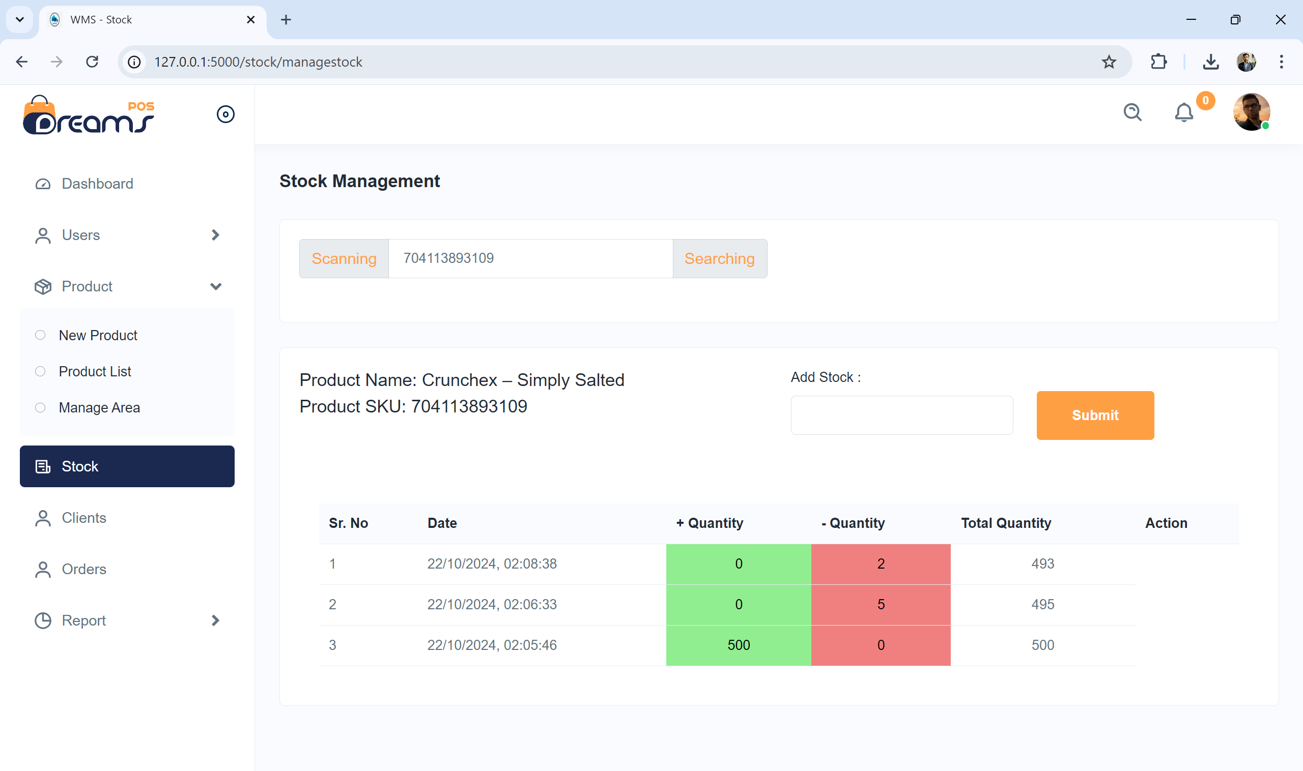
User Interface
41

Slide 42
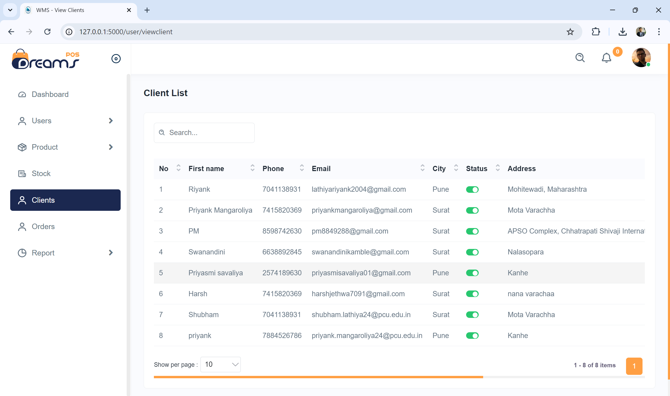
User Interface
42

Slide 43
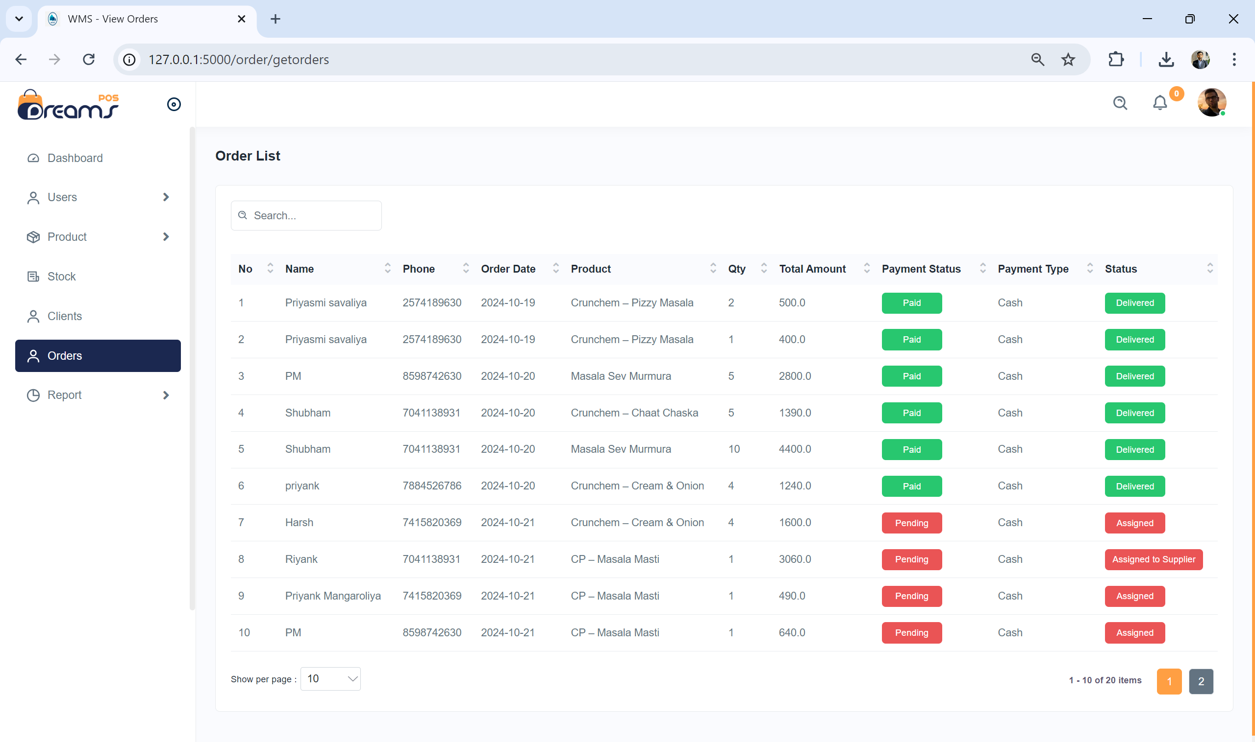
User Interface
43

Slide 44
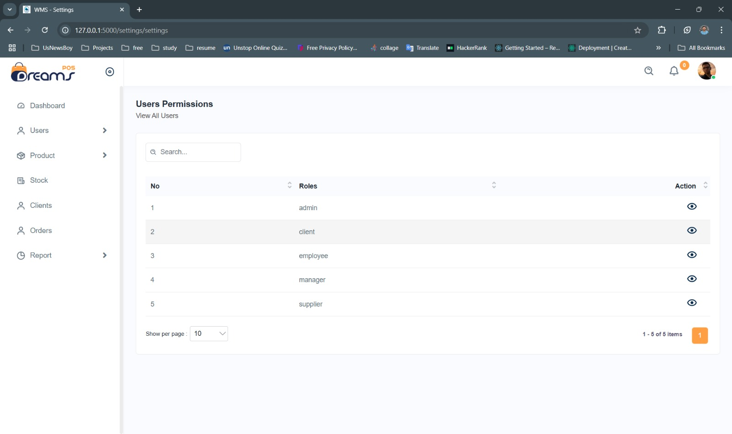
User Interface
44

Slide 45
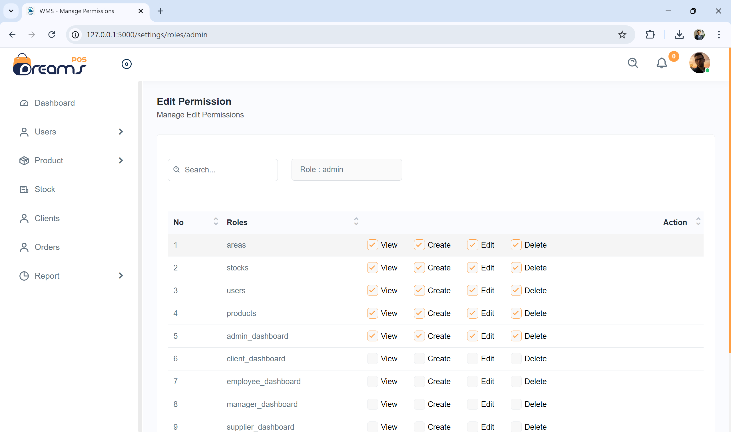
User Interface
45

Slide 46
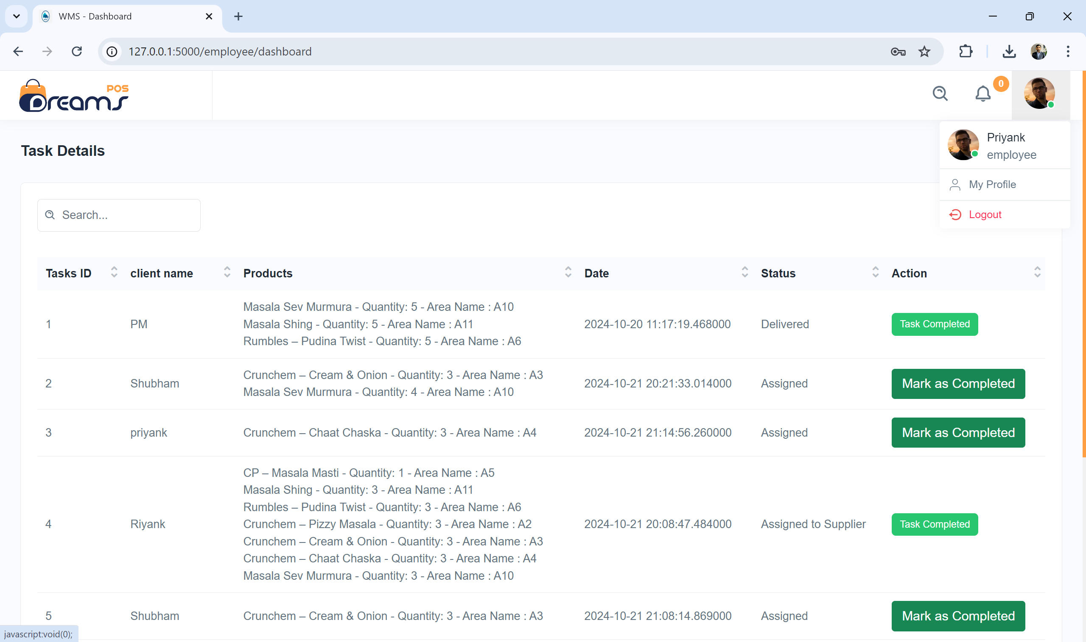
User Interface
46

Slide 47
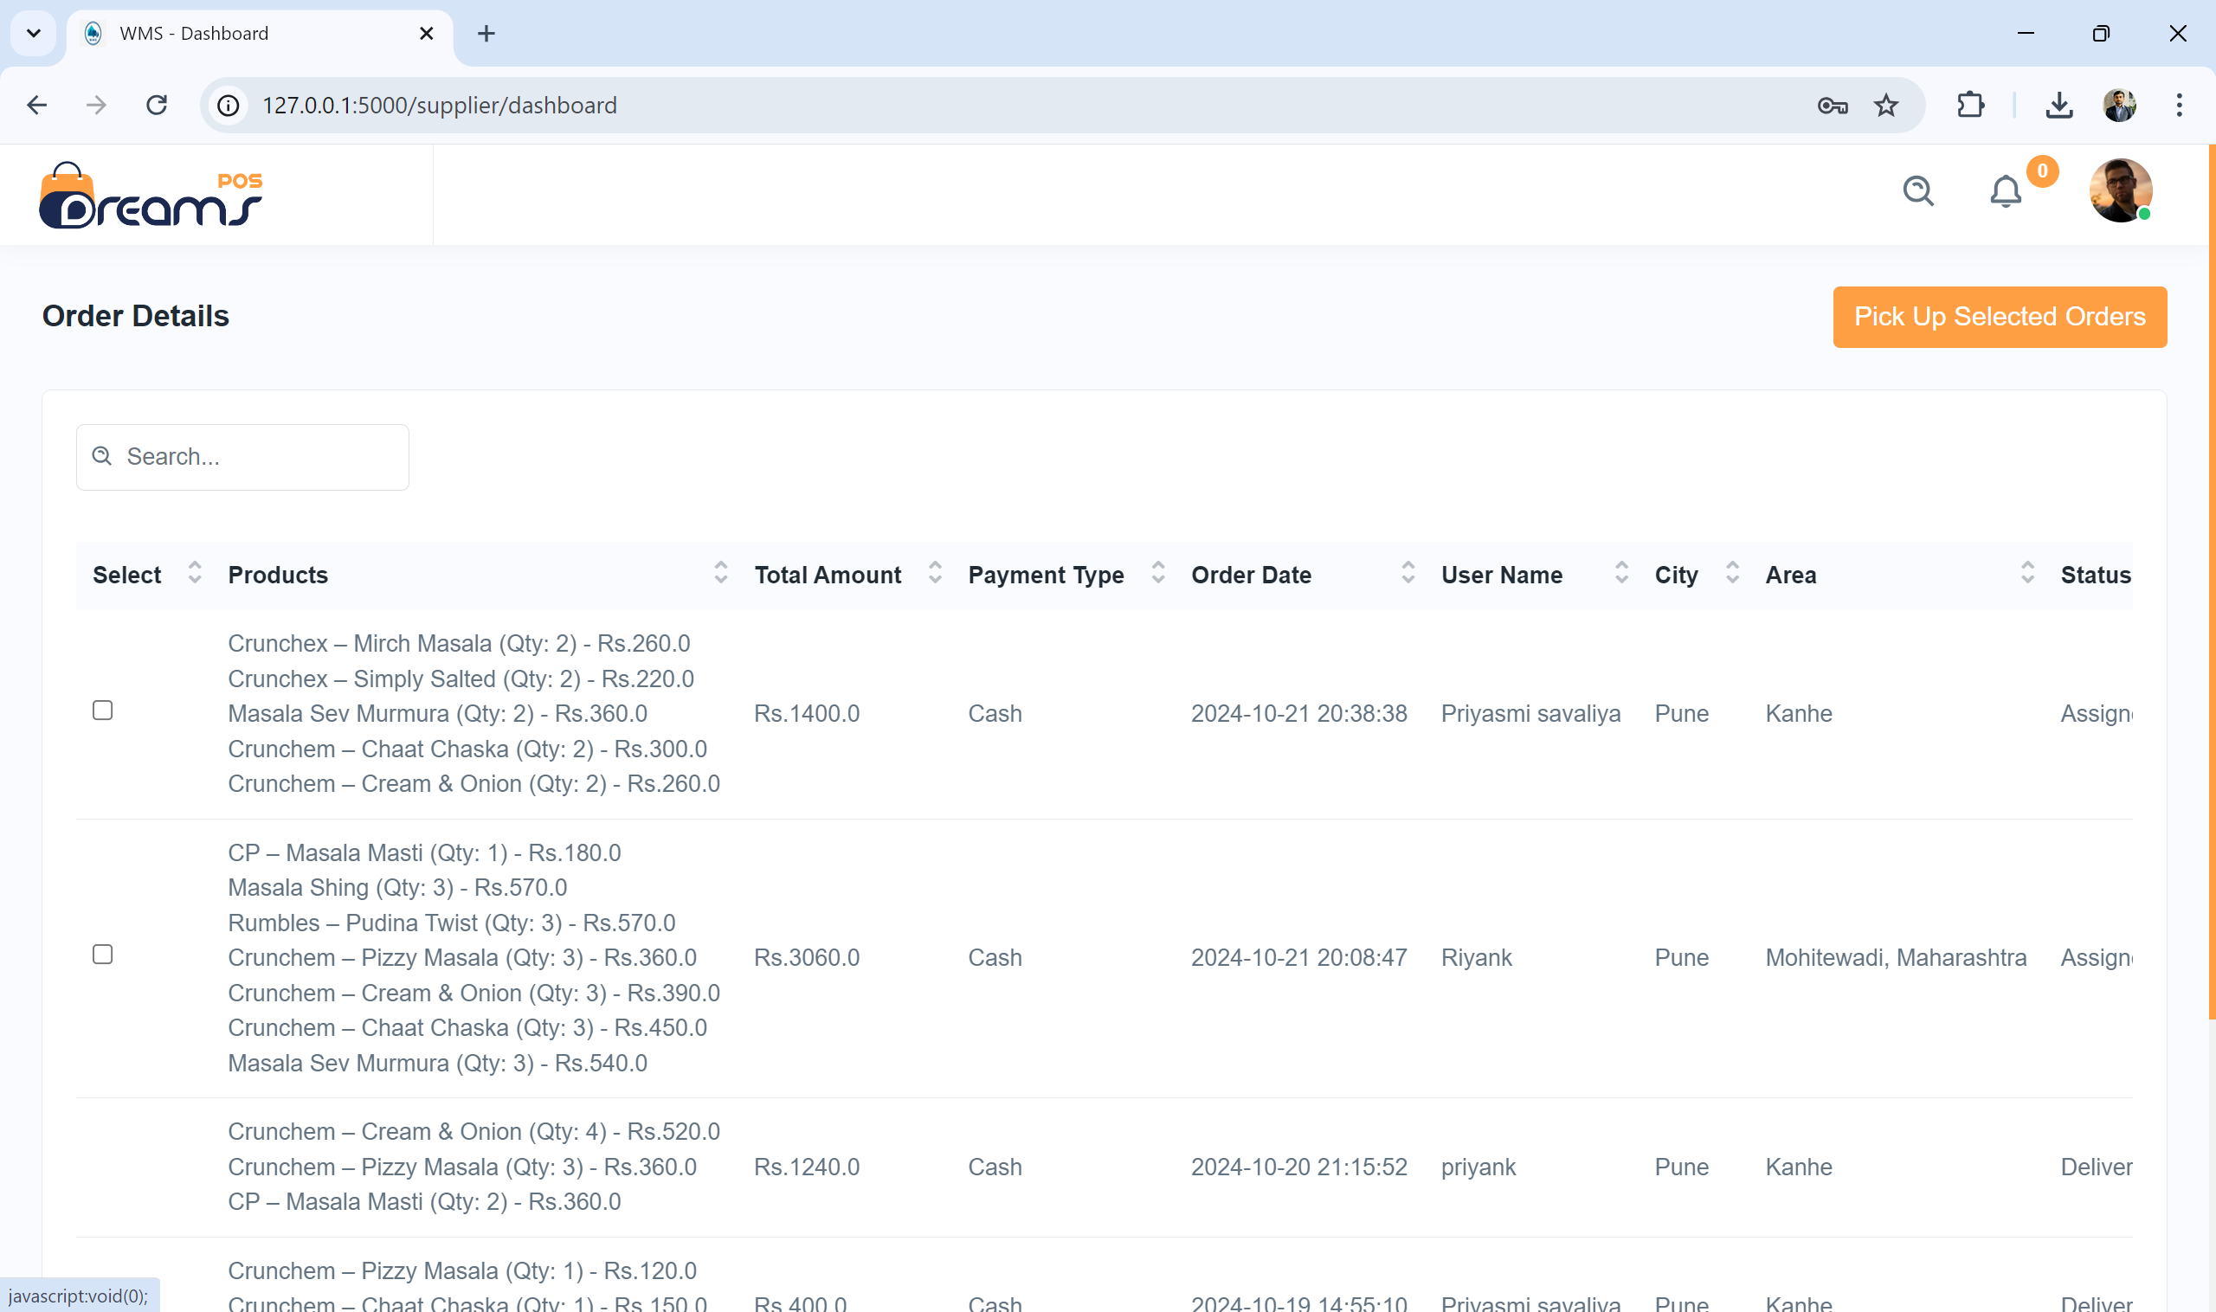
User Interface
47

Slide 48
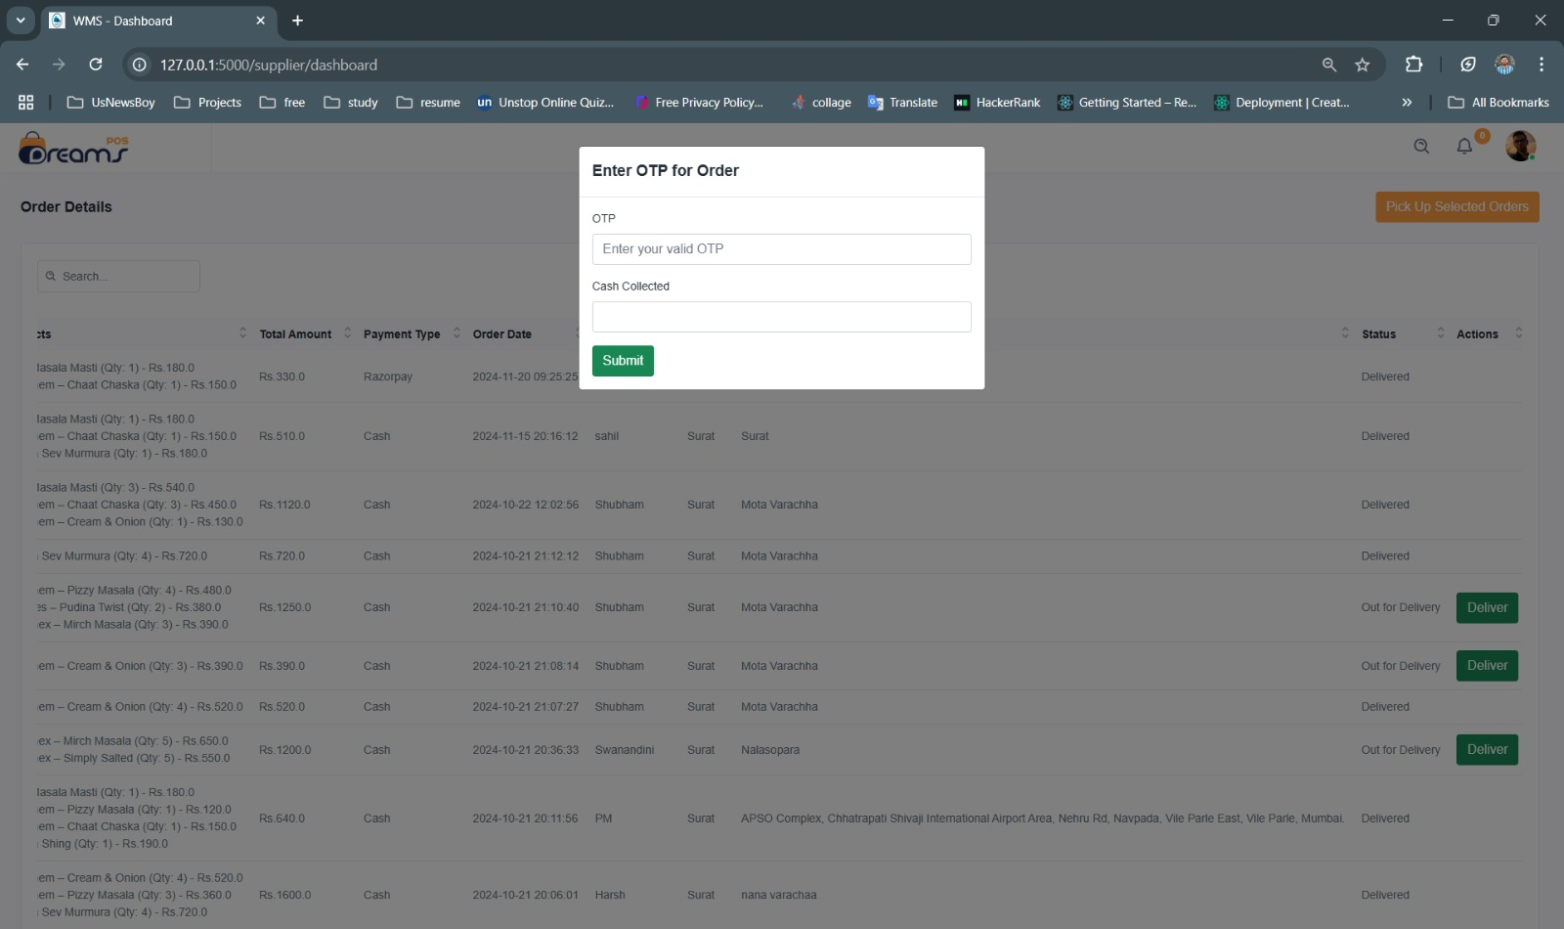
User Interface
48

Slide 49
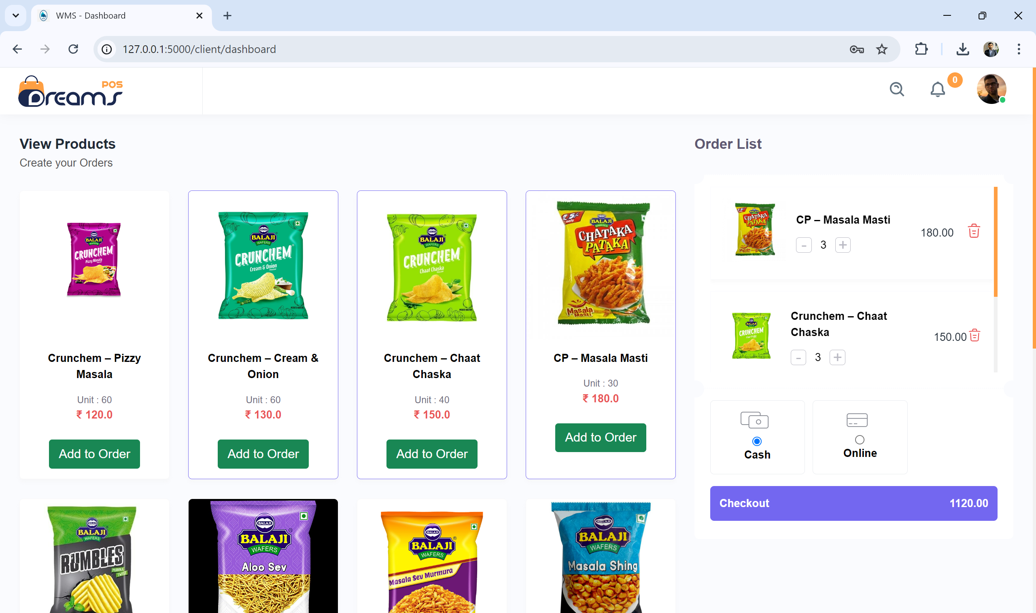
User Interface
49

Slide 50
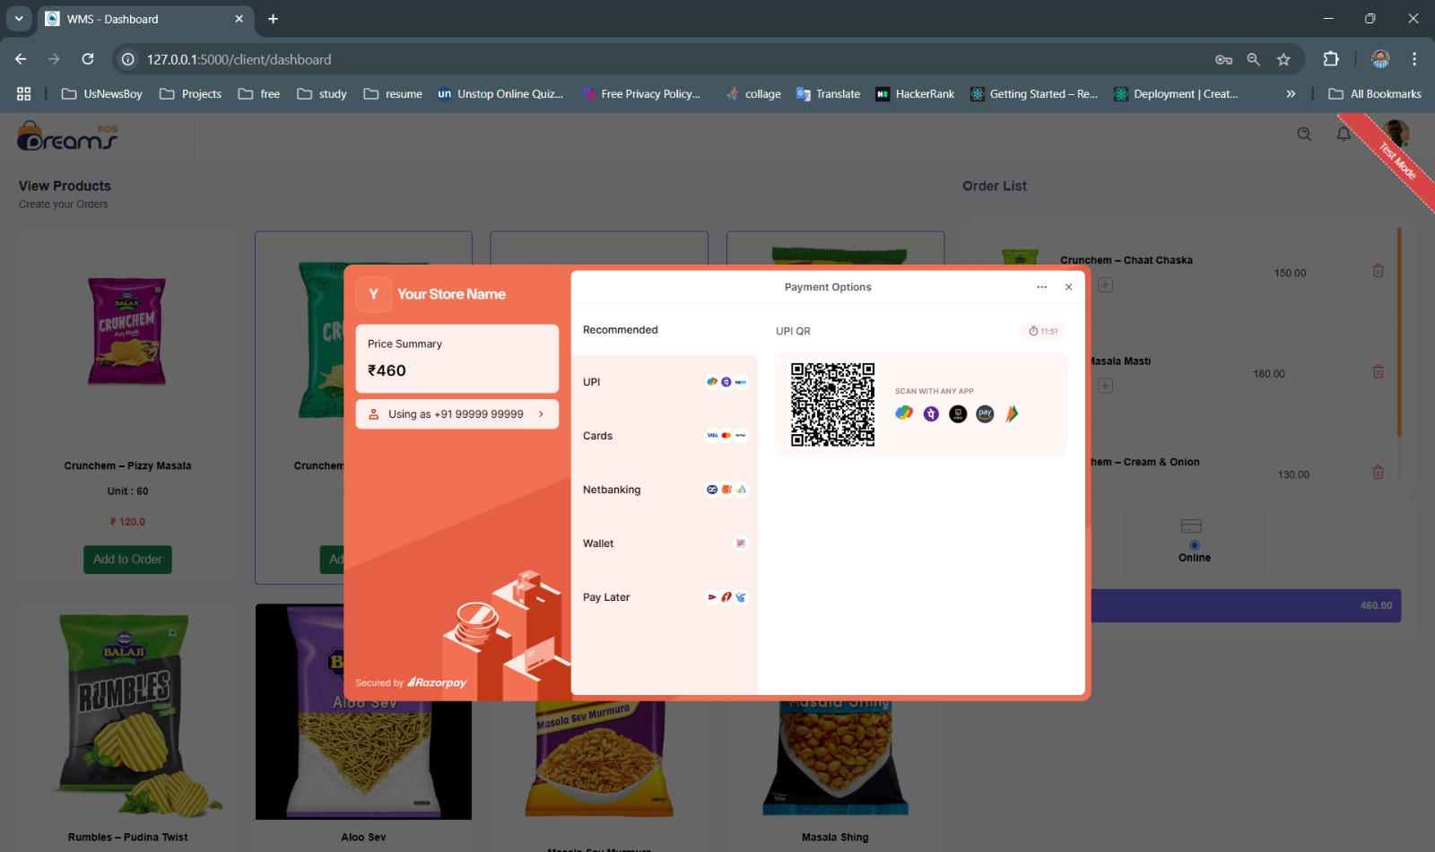
User Interface
50

Slide 51
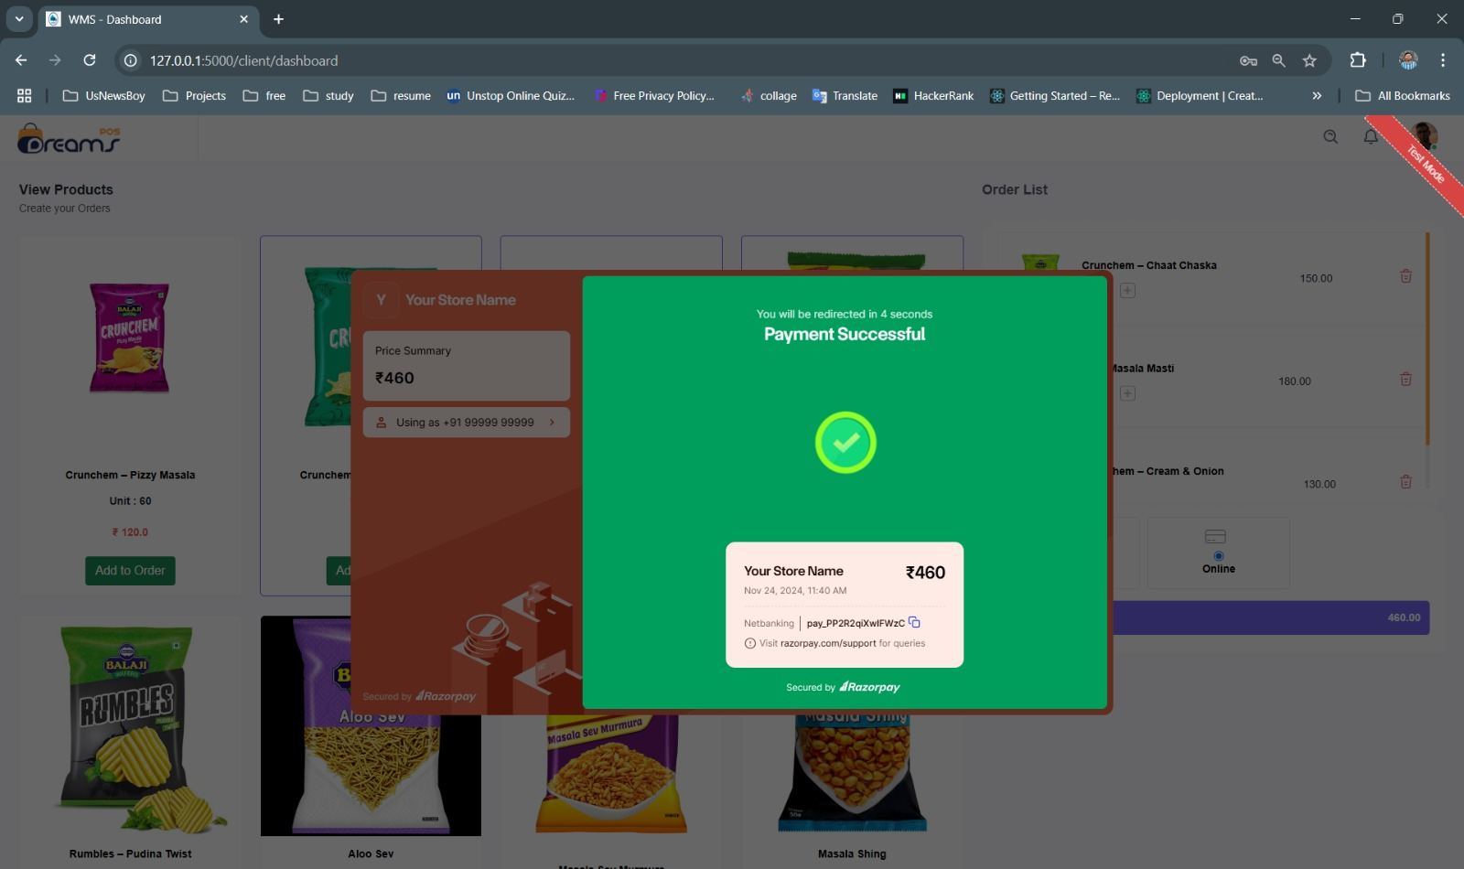
User Interface
51

Slide 52
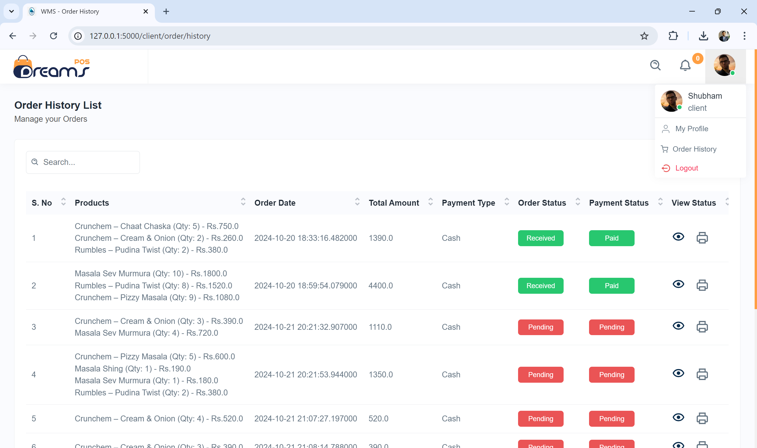
User Interface
52

Slide 53
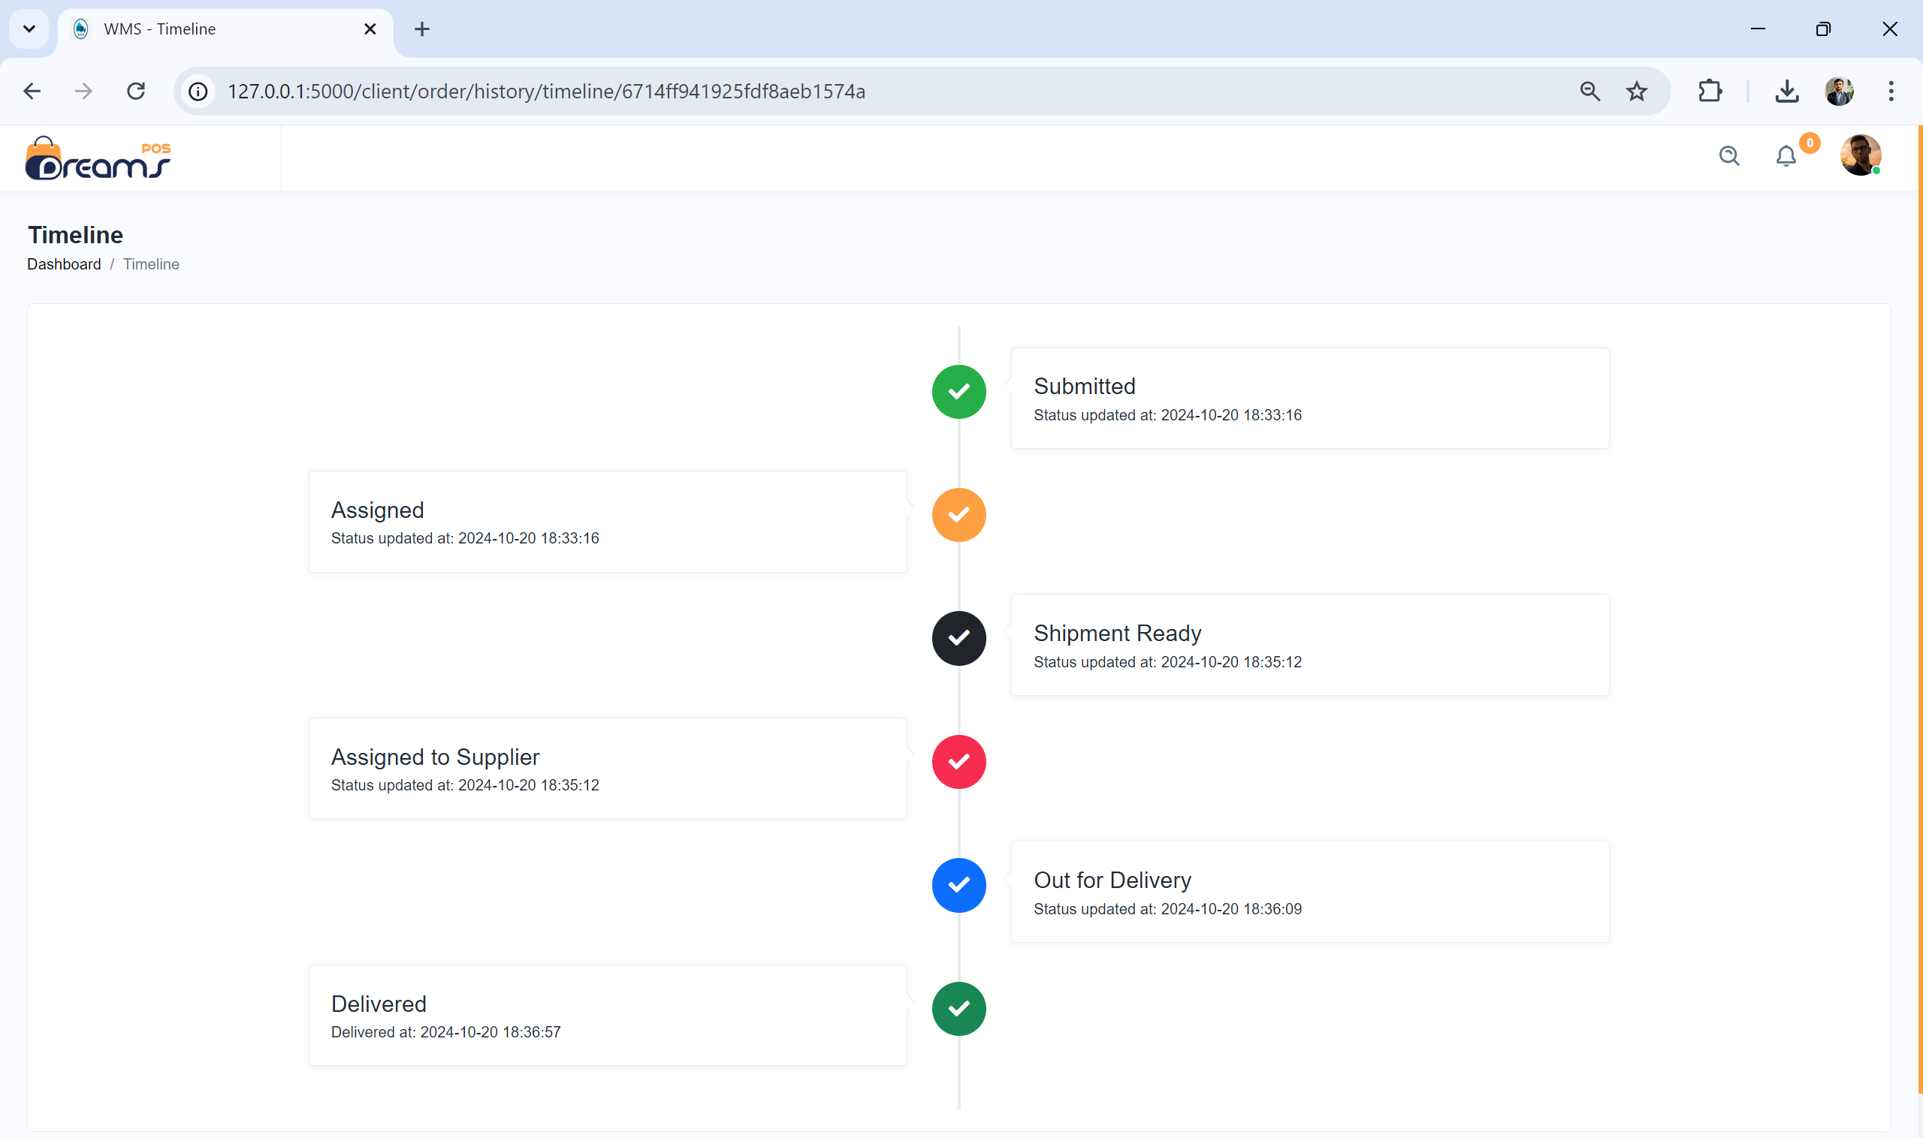
User Interface
53

Slide 54
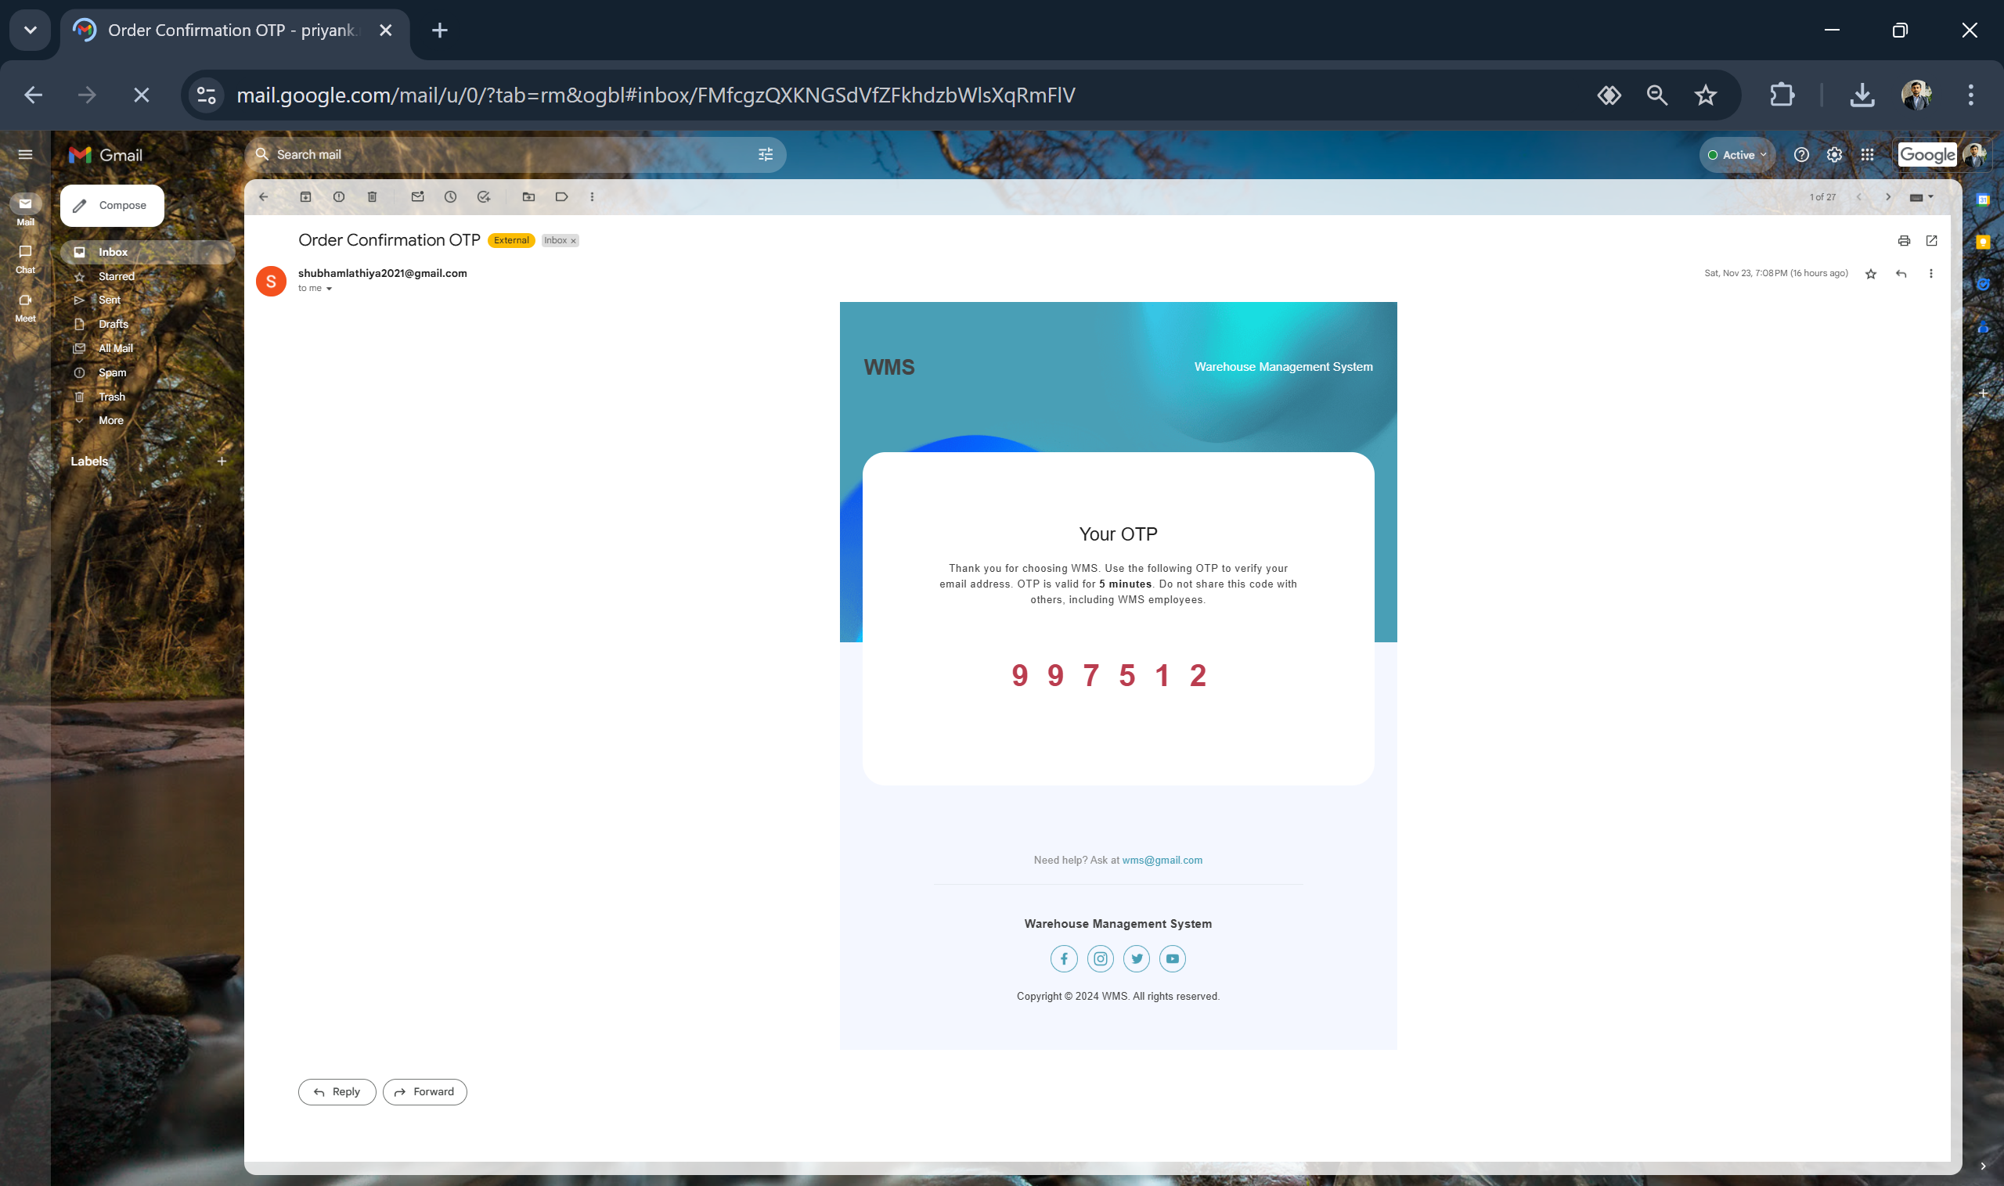
User Interface
54

Slide 55
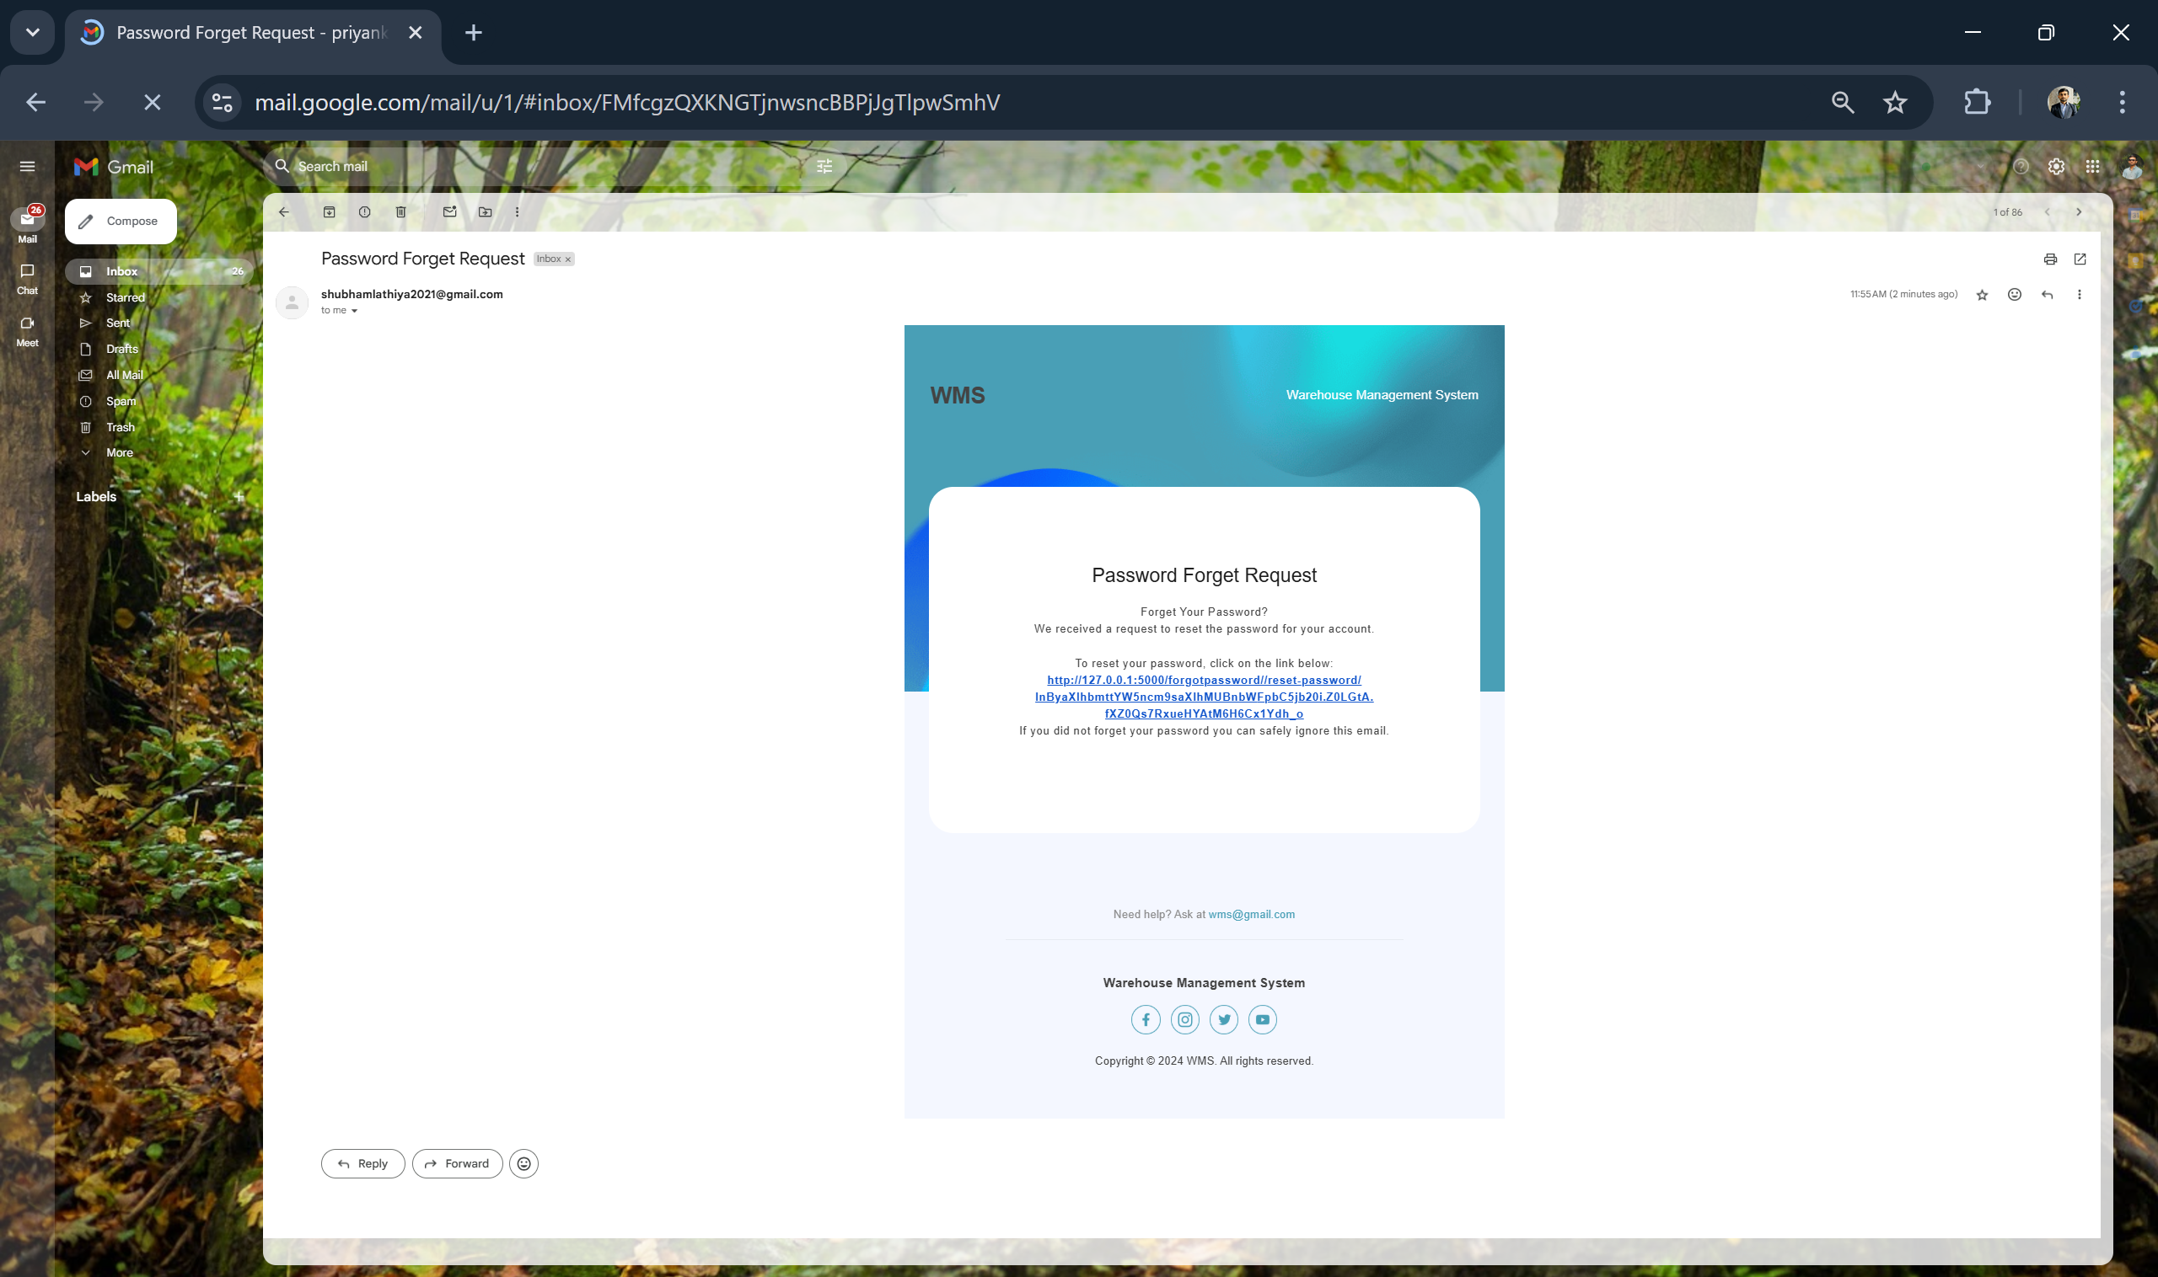
User Interface
55

Slide 56
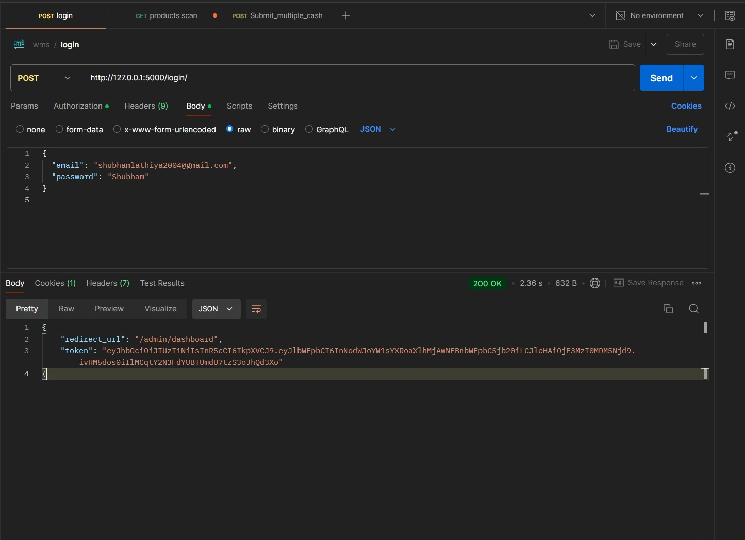
Testing
56

Slide 57
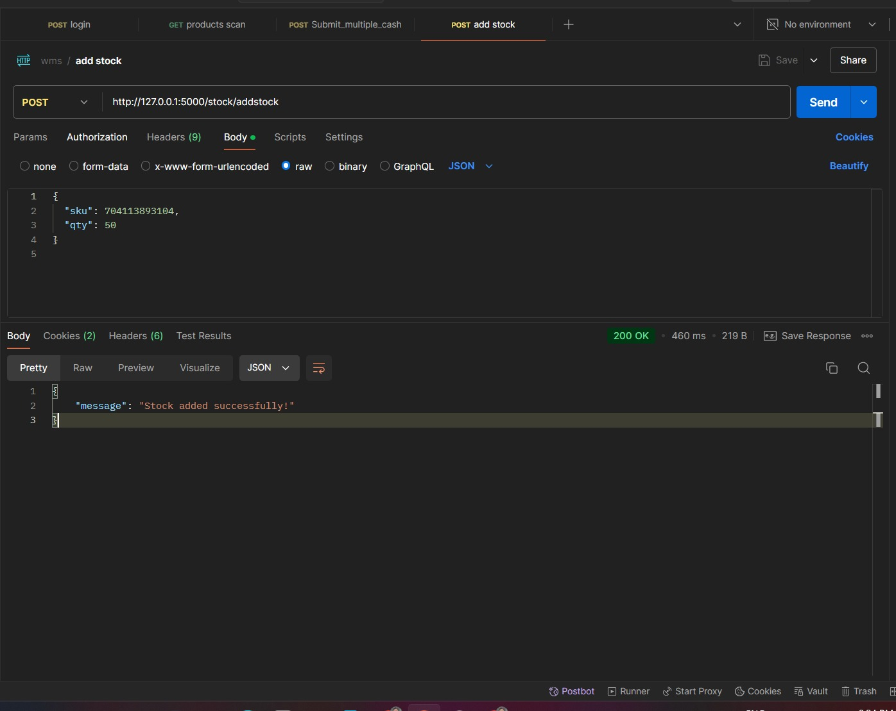
Testing
57

Slide 58
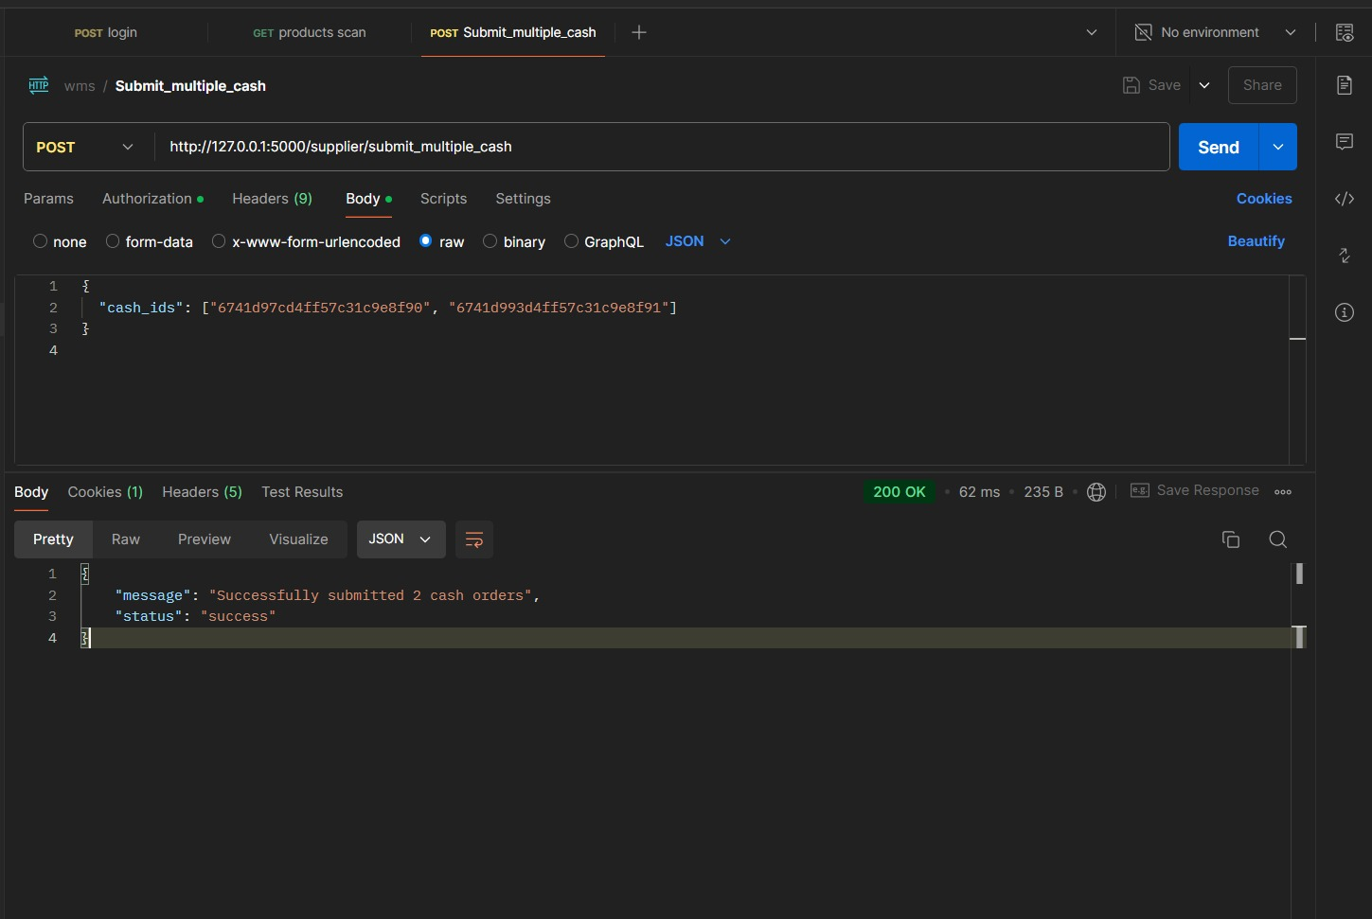
Testing
58

Slide 59
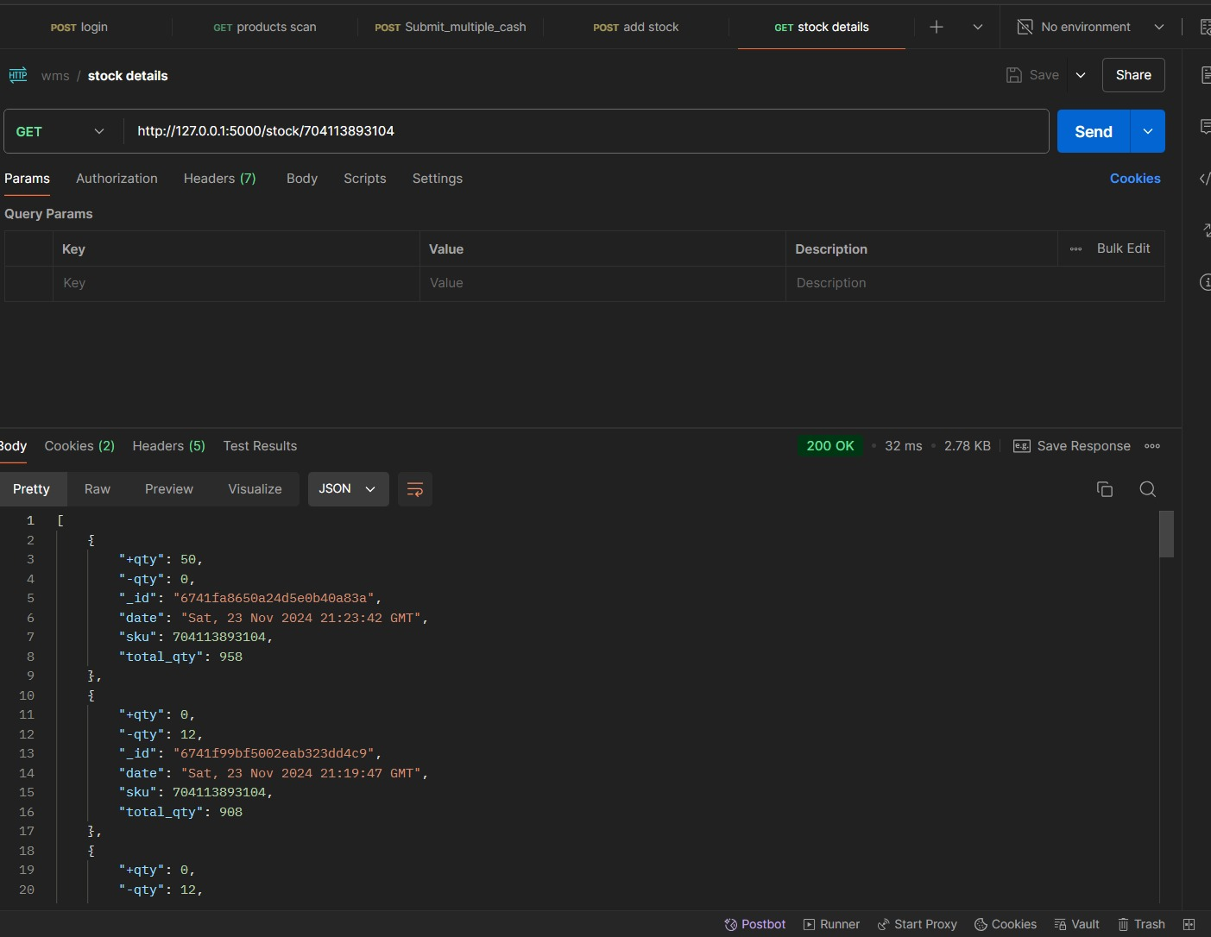
Testing
59

Slide 60
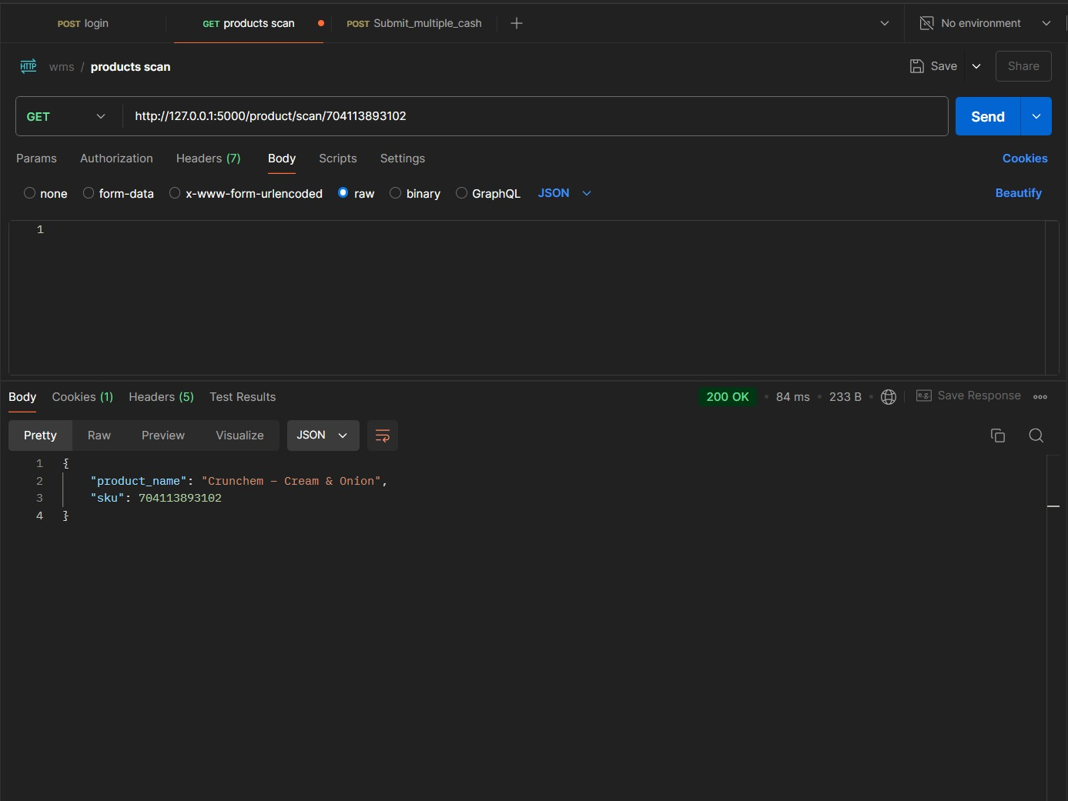
Testing
60

Slide 61
Testing
61
Test Case ID | Test Case Name | Input Data | Expected Output | Actual Output | Test Status
TC_01 | Retrieve stock by valid SKU | SKU: 1001 (valid SKU) | Stock details for SKU: 1001 with fields total_qty, +qty, -qty, and date. Example: { "sku": 1001, "total_qty": 100, "+qty": 50, "-qty": 0, "date": "2023-11-23" } | Stock details for SKU: 1001 returned as expected. | Pass
TC_02 | Retrieve stock for non-existent SKU | SKU: 9999 (non-existent SKU) | Error message indicating "No stock found" for SKU 9999. Example: { "error": "No stock entries found" }. | Error message No stock entries found returned correctly. | Pass
TC_03 | Test unauthorized access (no JWT token) | SKU: 1001, No JWT token | Error message indicating unauthorized access. Example: { "error": "Authentication required" }. | Error message Authentication required returned. | Pass

Slide 62
Testing
62
Test Case ID | Test Case Name | Input Data | Expected Output | Actual Output | Test Status
TC_04 | Retrieve stock for SKU with multiple stock entries | SKU: 1001 (Multiple entries) | Multiple stock entries for SKU 1001, each showing total_qty, +qty, -qty, and date. Example: [ { "sku": 1001, "total_qty": 100, "+qty": 50, "-qty": 0, "date": "2023-11-23" }, { "sku": 1001, "total_qty": 200, "+qty": 100, "-qty": 0, "date": "2023-11-24" } ] | Multiple stock entries returned as expected. | Pass
TC_05 | Test stock retrieval with invalid SKU format | SKU: 'ABC' (invalid format) | Error message indicating invalid SKU format. Example: { "error": "Invalid SKU format" }. | Error message Invalid SKU format returned correctly. | Pass
TC_06 | Test stock retrieval with missing SKU parameter | SKU: (empty) | Error message indicating SKU is required. Example: { "error": "SKU is required" }. | Error message SKU is required returned correctly. | Pass

Slide 63
Expected Outcomes
Admin: Manage users, settings, integrations, and the whole system with real-time visibility, improved decision-making, and enhanced security.
Manager: The Warehouse Manager ensures efficient warehouse performance by monitoring inventory, order processing, and workflows with real-time data access.
Employee: Automates daily tasks like inventory updates, picking, and packing. Makes their tasks easier and more efficient by scanning barcodes and generating picking lists.
Client: The system allows clients to place orders and track them in real-time. They get order tracking at every step, order confirmation, picking, packing, and shipping.

Slide 64
Conclusion
Warehouse Management Systems (WMS) streamline inventory management, order processing, picking, packing, shipping, and reporting in a single warehouse. Insightful analytics will help you make better decisions, automate critical warehouse operations, and improve real-time data tracking.

Slide 65
Thank you

